Slide 1
Board of Public Health Meeting
Tuesday, March 10, 2015

Slide 2
Commissioner’s Update
Brenda Fitzgerald, MD
Commissioner, DPH

Slide 3
Lead and Healthy Homes Program
Dr. Chris Rustin, DrPH, M.S., REHS
Environmental Health Section Director, DPH

Slide 4

Lead and Healthy Homes Mission
Inform the public about housing hazards that cause unsafe or unhealthy living environments
Prevent illness and injury through monitoring, assessments, education and provision of direct services
Protect all generations of Georgians by ensuring that each home is safe and healthy

Slide 5

Lead and Healthy Homes Program
Home is designed, built, and maintained to support health
  90% of time spent indoors
  Respiratory health
  Home safety
  Pests
  Indoor Air Quality
  Lead Poisoning

Slide 6
Program at a Glance
Program began in 1990s
Staff:
  Director, Two Program Consultants, Medical Epidemiologist, Administrative Assistant
Six State Funded Regional Healthy Homes Coordinators: Responsible for addressing lead and healthy homes issues in their assigned areas
50 +NEHA certified Healthy Homes Specialists statewide
30 EPD certified Lead Inspectors/Risk Assessors statewide
Funding:
CDC Grant-$365,000/year
State funding-$201,000 year
PHBG Funding-$183,500 year

Slide 7




Lead Deliberately Added To Residential Paint and Gasoline
Provided paint durability, elasticity, repelled mold, resisted corrosion, speeds drying
Engine knock
Lead chromate
Lead carbonate
Tetraethyl Lead

Slide 8

Lead Paint Statistics-1978 Banned
<1940 homes-87% lead paint
1940-1960-69% lead paint
1961-1977-24% lead paint
Source: Georgia EPD

Slide 9

Exposure Sources
Household
Lead Paint
Lead Dust
Secondary: Toys and Food
Notes:
True” Prevention
Prevent/Control lead hazards BEFORE exposure occurs
And includes all exposure sources
However it focuses on the major lead sources

Slide 10
Risk Variables
Across all income levels, lead exposure risk is higher for:
African American children
Medicaid children
Poor children
Children living in pre-1978 housing that are dilapidated or undergoing renovation
-Risk is higher in pre-1950
-Rental Property

Slide 11
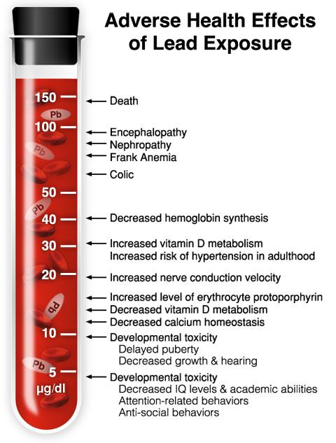
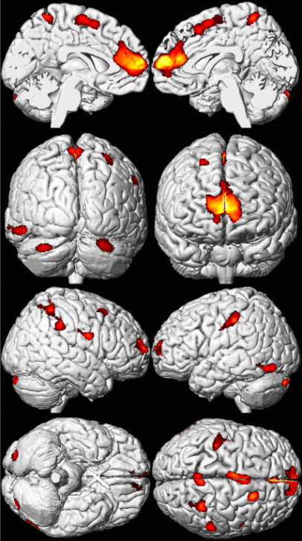
Health Effects
Effects
CNS damage
Intellectual and behavioral deficits
Speech and Language
Coordination
Delinquency & Crime
Cognitive effects may not be reversible

Slide 12
Blood Lead Levels Considered to be Elevated by CDC
GA-Environmental Action Level
New CDC Reference Level
Adapted from Gilbert & Weiss, 2006
Notes:
Action level

Slide 13
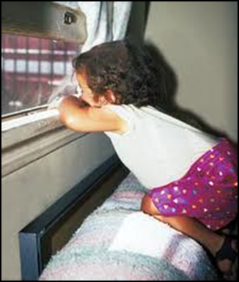
Focus on Children <6 Years Age
Pathways of Exposure
Eating (Ingestion)
  Lead particles / dust on hands transferred to food, drinks and children sucking on their fingers (Floors, window sills)
  Paint chips (walls, floors)
  Soil (play areas)
  Breathing (Inhalation),
  Lead particles in the air
  Higher Metabolism
  6% absorbed in adults and excrete about 99%
  50-70% absorbed in children and excrete only 32%

Slide 14
Blood Lead Prevalence

Slide 15

Current Public Health Issues
Housing, health, economic disparities
History of treating the exposed rather than removing the source
Low testing rates
Universal Testing vs. Targeted
Minimal targeting of prevention efforts
Physician Apathy
Landlords & rental properties
Funding
Notes:
In our efforts to eliminate lead poisoning of Indiana’s children by 2010, we have identified major barriers

Slide 16

Clinician Role is Critical
Risk questionnaire and education
Lead testing children per guidelines and reporting BLL
Emphasizing healthy nutrition and/or dietary supplements
Test for iron deficiency
Coordinated case management
Referral to DPH for investigation

Slide 17
Case Management Guidelines and Medicaid Requirements
Universal testing of all Medicaid children through EPSDT services is required:
  1 lead test at 12 and 24 months
  OR 1 test between 36-72 months if no previous testing conducted
  BLL >=5ug/dL-9ug/dL-Anticipatory guidance and Re-test within 1 year or sooner
  BLL >=10ug/dL-Confirmatory Re-test 1 day-3 months
  http://dph.georgia.gov/lead-screening-case-management-lab-submissions-reporting-guidelines

Slide 18
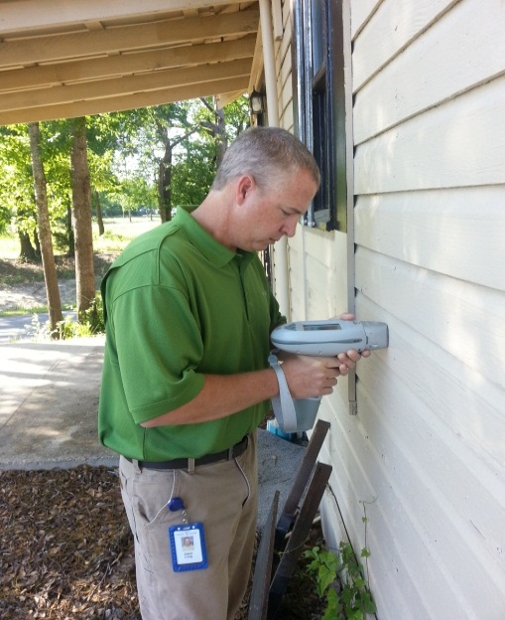
EBL Investigation Process
All blood lead levels are reportable to DPH-EH
EBL’s are assigned in SENDSS to a Regional Lead Coordinator for Environmental investigation
  Case Mgt Guidelines
  Source
  Education
  Enforcement

Slide 19
Total # Children Tested<6 Years of Age-2013
District | Total Number Screened | 5-9ug/dL | >=10ug/dL
(1-1) Northwest (Rome) | 5,744 | 128 | 28
(1-2) North Georgia (Dalton) | 3,750 | 66 | 7
(2) North (Gainesville) | 7,180 | 129 | 31
(3-1) Cobb/Douglas | 8,275 | 121 | 21
(3-2) Fulton (Atlanta) | 11,554 | 161 | 26
(3-3) Clayton (Morrow) | 3,938 | 62 | 5
(3-4) East Metro (Lawrenceville) | 10,895 | 192 | 42
(3-5) DeKalb (Decatur) | 7,103 | 148 | 27
(4) LaGrange | 7,533 | 230 | 40
(5-1) South Central (Dublin) | 2,062 | 91 | 26
(5-2) North Central (Macon) | 5,574 | 166 | 34
(6) East Central (Augusta) | 2,625 | 102 | 24
(7) West Central (Columbus) | 3,563 | 163 | 37
(8-1) South (Valdosta) | 1,890 | 75 | 15
(8-2) Southwest (Albany) | 5,361 | 226 | 30
(9-1) Coastal (Savannah) | 7,173 | 291 | 49
(9-2) Southeast (Waycross) | 5,177 | 144 | 19
(10) Northeast (Athens) | 5,095 | 108 | 23
State | 104,492 | 2,603 | 484
Source: GCLPPP Database
6.15% children with BLL >=5-9ug/dL do not have a follow-up test in one year or sooner
47.17% children with BLL >=10ug/dL, do not have a confirmatory test

Slide 20
Overall Testing Rates

Slide 21
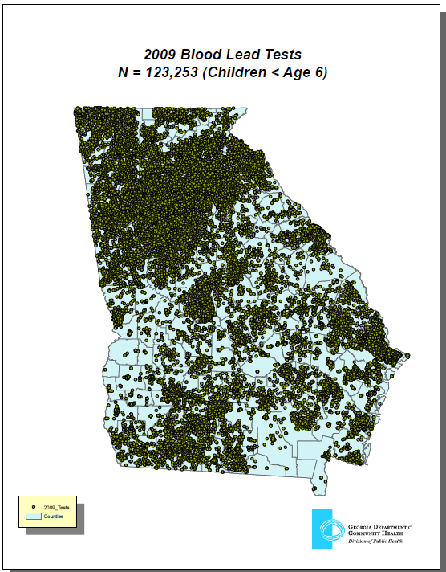
Universal Screening
No focus on highest risk children
Current funding demands best use of scarce resources.
Recommended by CMS and CDC to target high risk housing and children
GIS is important tool to targeting risk

Slide 22
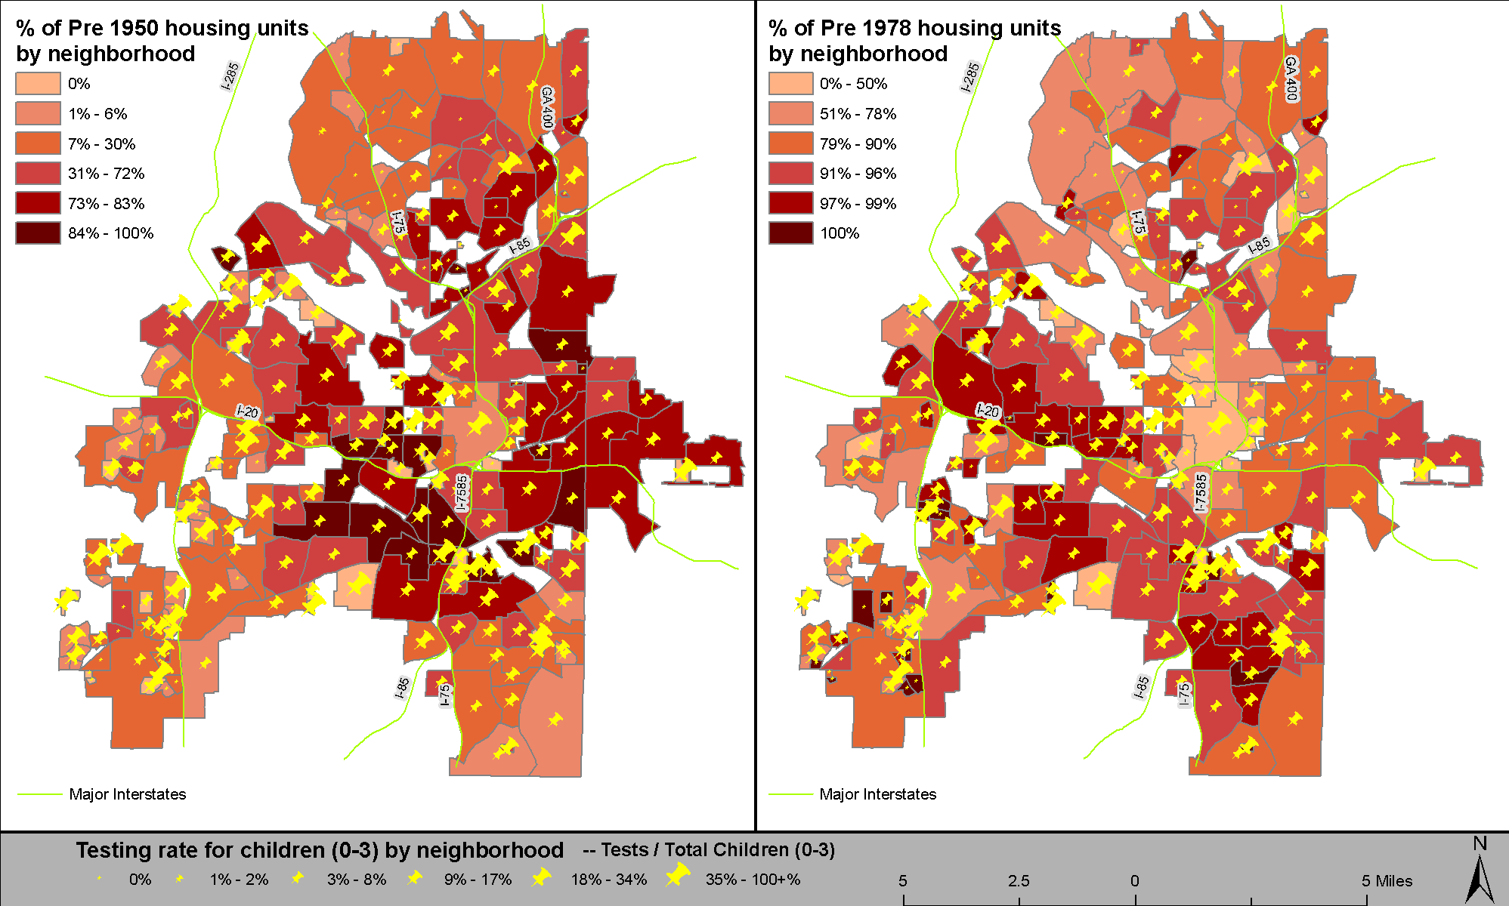
Universal Screening
Pre 1950 and 1978 housing concentrated in central Atlanta
Testing rate does not match housing risk

Slide 23
Goals
Targeted approach = Primary Prevention
Outreach and education with Pediatricians
Improved testing of high risk children
Collaboration with other programs
Enforcement

Slide 24
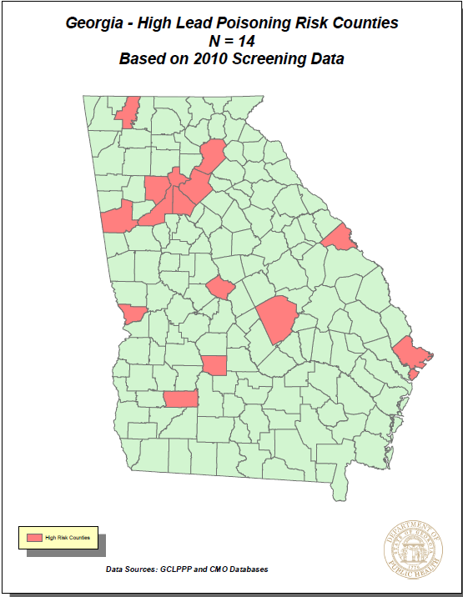
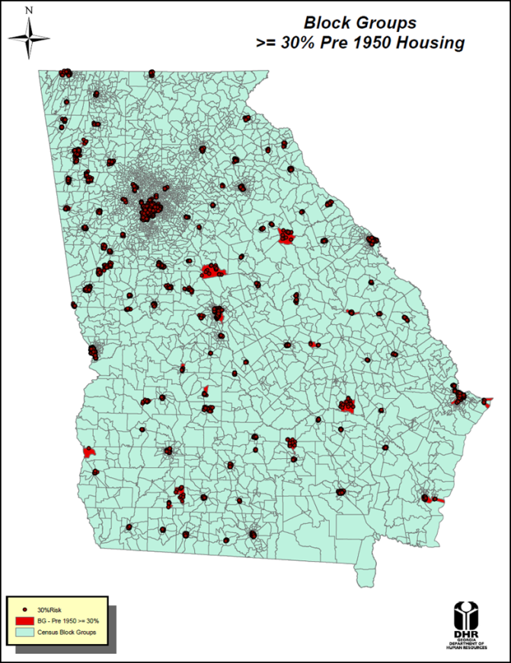
Targeted Approach-GIS
County
Bibb
Carroll
Chatham
Cobb
Crisp
DeKalb
Dougherty
Fulton
Gwinnett
Hall
Laurens
Richmond
Whitfield Ben Hill

Slide 25
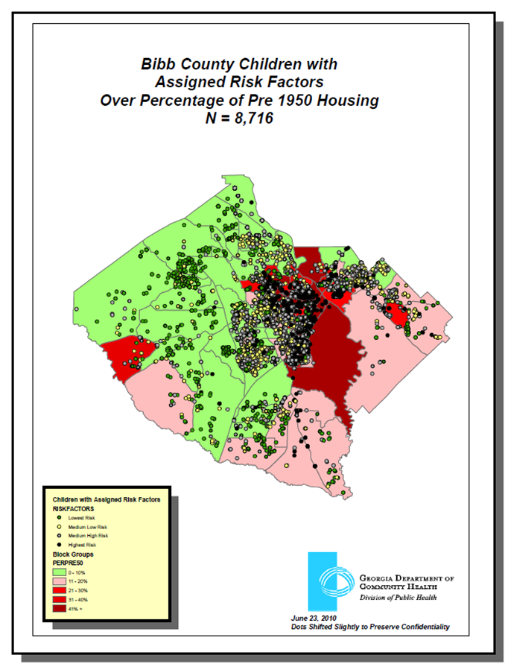
Remember this map

Slide 26
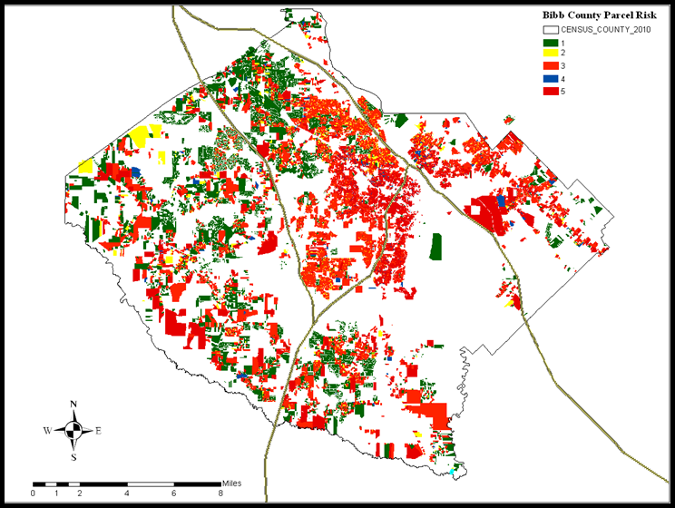
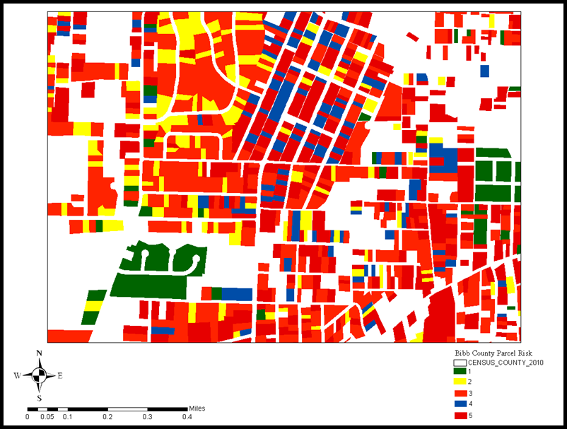

Slide 28
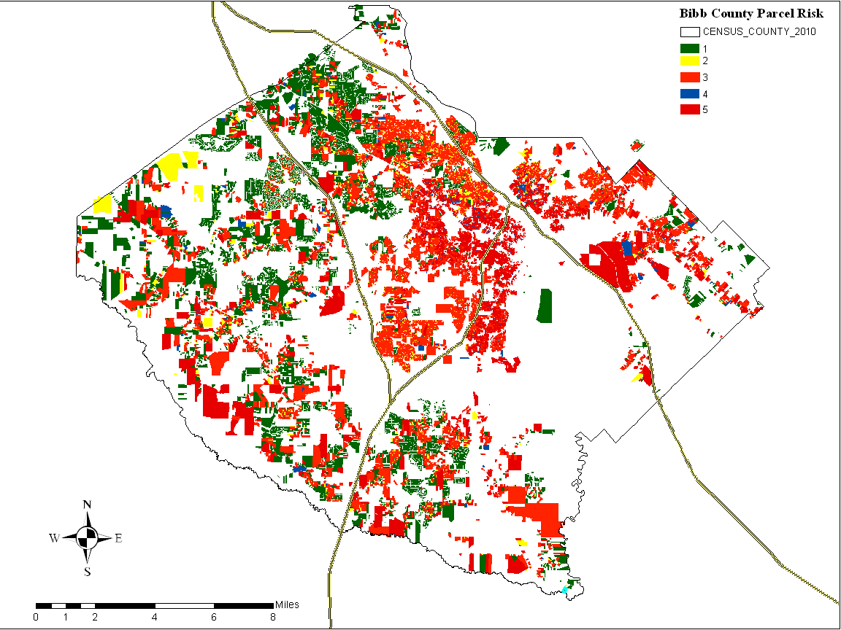


Slide 29
Implication for Public Health Programs and Policy
Targeted approach to improve community health
Incorporate model within GRITS immunization system to increase testing of high risk children
Target high risk neighborhoods
Potential exemption of lower risk Medicaid children from being tested by requesting CMS waiver
  Saves dollars
  Reroute portion of savings to target higher risk areas

Slide 30
WIC and Lead Partnership
Data sharing agreement (Fe deficiency Anemia)
Some WIC children are not tested for lead
Iron Supplements

Slide 31
Asthma and Healthy Homes
EH assistance with Asthma Strategic Plan
Participate in cross departmental leadership meetings to focus on Asthma
Local EH Staff will receive specific training to provide Asthma Management Training to clients in Pilot Districts

Slide 32
Performance Metrics
Number of Lead/HH investigations at an EBL of >=10ug/dL
Adherence to investigation timelines established by case management guidelines
Number of investigations where lead hazards were identified and homes made lead safe

Slide 33
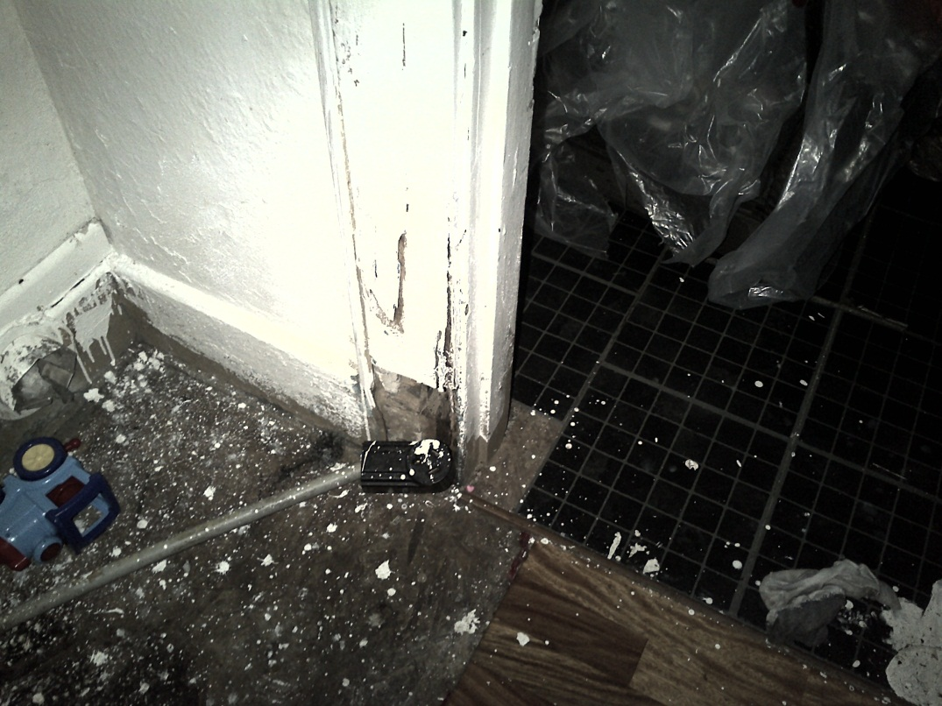
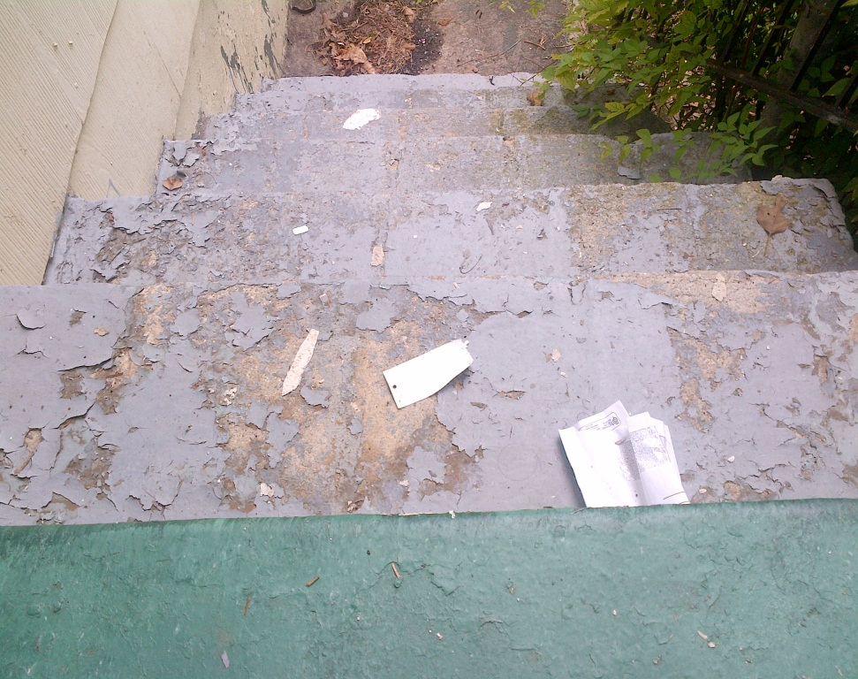
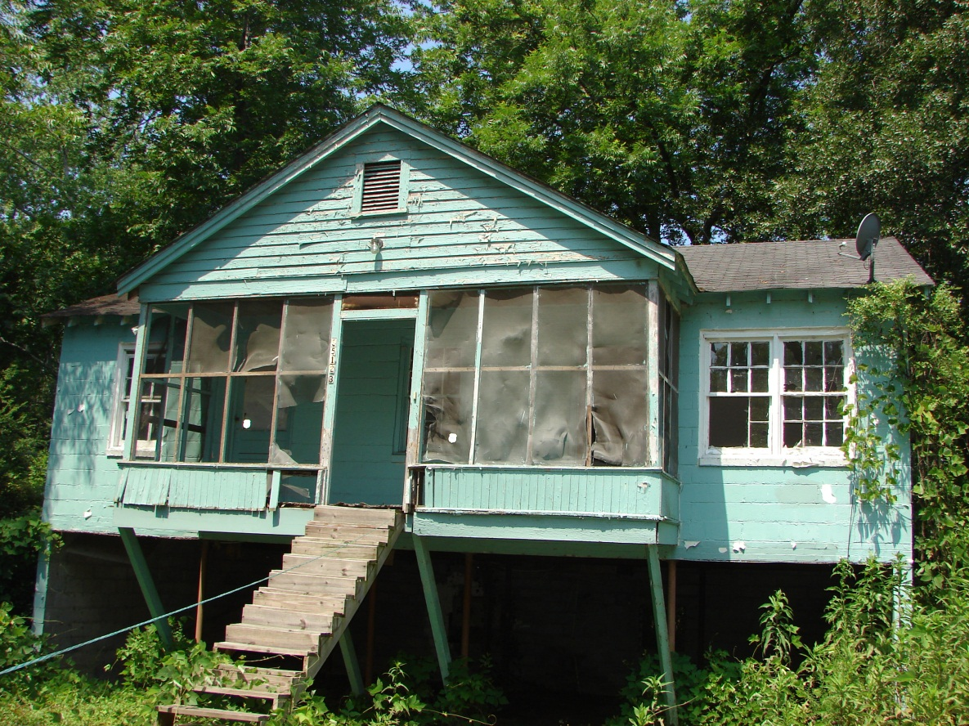
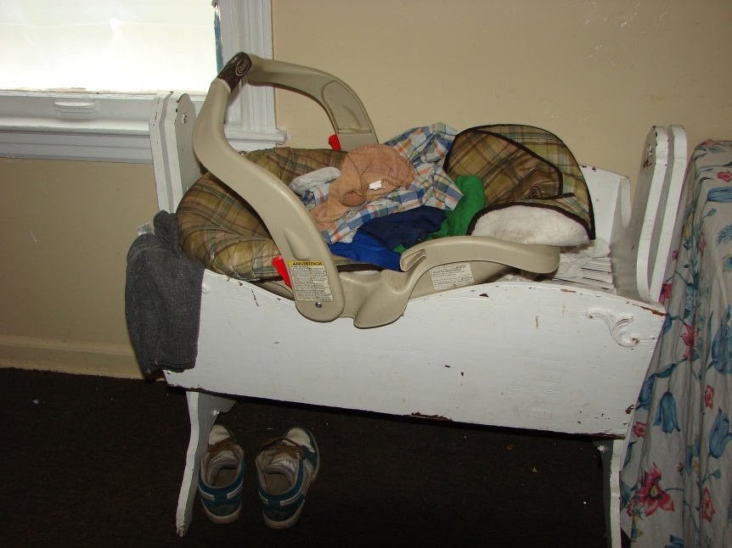

Slide 34
Questions or Comments?
Dr. Chris Rustin, DrPH, M.S., REHS
Director, Environmental Health Section
Georgia Department of Public Health
Division of Health Protection
Chris.Rustin@dph.ga.gov

Slide 35
FY 2016 Budget Update
Kate Pfirman, CPA
Chief Financial Officer, DPH

Slide 36
AFY15 Changes by Governor
Adolescent & Adult Health Promotion - $651,897
 | Replace federal funds. |  | $651,897
The above funds are for our Women’s Health program. The amended budget has been signed by the Governor.
Notes:
Need to add Senate tracking numbers

Slide 37
FY2016
Total Budget: $635,124,619
Attached agencies not included

Slide 38
FY2016 Changes by Program
Adolescent & Adult Health Promotion - $75,000
 | Provide matching funds for the Georgiacancerinfo.org website. | $75,000
Emergency Preparedness - $2,834,053
 | Increase funds to reflect the movement of statutory responsibilities from the GA Trauma Commission (SB 60, 2007 Session) | $2,834,053
Infant & Child Essential Health Treatment Services - $3,584,575
 | Increase funds for the Georgia Comprehensive Sickle Cell Center. | $50,000
 | **Utilize other funds to provide therapies for children with congenital disorders pursuant to O.C.G.A. 31-12-9 (Newborn Screening) | $3,534,575
Notes:
Need to add Senate tracking numbers

Slide 39
FY2016 Changes by Program
PH Formula Grants to Counties - $1,521,306
 | Fifth-year phase-in for the general grant-in-aid formula to hold harmless all counties | $1,388,991
 | Increase funds for personal services | $132,315
Statewide Changes (All budget programs) - $6,647,862
 | Merit Based pay adjustments and employee recruitment and retention initiatives | $2,441,096
 | Increase funds to reflect and adjustment in the employer share of the Employee's Retirement System | $4,206,766
Statewide Changes-Administration-($38,574)
 | Adjustment to agency premiums | ($92,918)
 | Adjustment in Teamworks billings | $54,344
 | Total State Fund Changes | $11,089,647
 | **Total Other Fund Changes | $3,534,575
 | FY 2016 Recommended Changes | $14,624,222
Notes:
Need to add Senate tracking numbers

Slide 40
FY2016 State Funds
Notes:
We need to make a tobacco slide.

Slide 41
General Obligation Bonds
$10,000,000
$9,300,000
  Clinical Billing Information Technology system
$400,000
  Replacement of second chiller at Decatur Lab
$300,000
  Replacement of walk-in coolers at the Decatur Lab
Notes:
Add Senate tracking numbers

Slide 42
QUESTIONS?

Slide 43
Update on Consortium and
Georgia Cancer Control Strategic Plan, 2014-2019
Daniel Thompson, MPH
Deputy Director, Planning and Partnerships
Tamira M. Moon, MPH, CHES
Comprehensive Cancer Program Manager

Slide 44
Georgia Cancer Facts
2nd leading cause of death in Georgia
  The two leading cancer killers are lung and colorectal cancer
  Four types of cancer – lung, colorectal, breast, and prostate – account for more than half of all cancer deaths
  Lung cancer accounts for more deaths than colon, breast, and prostate combined
  Lung and prostate cancer mortality rates are nearly 16% higher than the national average.
Disproportionately impacts minority and medically underserved Georgians.
Total est. annual cost ≈$5 billion
Notes:
Cancer disproportionately impacts minority and medically underserved Georgians. Males are 43% more likely to be diagnosed with cancer than females. Black (non-Hispanic) men in Georgia are 14% more likely to be diagnosed with cancer than white men and 31% are more likely to die from the disease

Slide 45
DPH Cancer Programs
Comprehensive Cancer Cooperative Agreement from CDC
  BCCP
  Cancer Registry
  Management and Leadership
  Cancer Planning and Demonstration Projects
State funds
  Support cervical and breast cancer screening
  Cancer State Aid
  Fund five Regional Cancer Coalitions
    NW, East, GA CORE, CWH, South, West Central
Utilize Collective Impact for partnership development and program implementation
  Georgia Cancer Consortium

Slide 46





















Slide 47


Georgia’s Cancer Prevention and Control Priorities: 2014-2019
Cancer risk reduction – tobacco and obesity
Vaccination for human papilloma virus
Breast and cervical cancer screening
Colorectal cancer screening
Evidence based lung cancer screening
Quality cancer diagnosis and treatment
Access to palliative care and survivorship
Patient case management and care coordination

Slide 48
Cancer Risk Reduction – Tobacco and Obesity
Objective:
  Reduce Georgian’s exposure to tobacco and secondhand smoke, increase opportunities for physical activity and promote a health diet in early care settings, schools, worksites, and community settings
Activities:
  Support physical activity and healthy eating for youth in early care settings and schools
  Promote breastfeeding and healthy communities through policy, systems and environmental changes through Georgia’s SHAPE initiative
  Promote healthy worksites and access to worksite wellness programs
  Support the adoption of tobacco-free environments
  Reduce youth access to tobacco and alternative tobacco-products, including e-cigarettes
  Increase the number of people served through the Georgia Tobacco Quit Line

Slide 49

Cancer Risk Reduction – Tobacco and Obesity
Year 1 Accomplishments:
Medicaid match secured for GTQL
Tobacco-free policies enacted in Pooler, GA and Southeast Health District
USG Tobacco-free policy effective October 1, 2014; Berry College tobacco free
SHAPE Grants in Schools: $175,000 distributed to 47 schools in 25 counties impacts 34,000 students
443 elementary schools have signed the “Power Up for 30 Pledge” impacting 228,000 students

Slide 50

Vaccination for Human Papilloma Virus
Objective:
  Increase the number of females and males who receive the Human Papilloma Virus (HPV) vaccine
Activities:
  Make the offer of HPV vaccination by pediatric providers to parents of boys and girls routine by promoting it with other required and recommended vaccinations
  Engage community-based organizations to implement culturally appropriate cervical cancer communications campaign program targeted at all parents of young children
Notes:
OBJECTIVE: in accordance with the National Advisory Committee on Immunization Practices (ACIP) recommendations
ACTIVITIES: Engage community-based organizations to implement a comprehensive, innovative, culturally appropriate cervical cancer communications campaign program targeted at all parents of young children to help them understand the importance of HPV vaccination

Slide 51
Vaccination for Human Papilloma Virus
Year 1 Accomplishments:
Targeting female and male participants ages 11 and older and their guardians in Bartow, Floyd, Gordon, Catoosa, Chattooga, Polk, and Whitfield counties.
HPV MARTA Awareness campaign (August – December 2014).
  50 MARTA buses, 120 MARTA trains, and 20 MARTA bus shelters. The messages were seen 12.7 million times.
Pursuing federal funding opportunity to promote interventions that increase vaccination rates
GC3 conducted the following activities for Cervical Cancer Awareness Month (January 2015):
A letter signed by Commissioner Brenda Fitzgerald jointly distributed to GA-AAP members
Survey developed to set a baseline for the number of pediatric providers in Georgia who stock and routinely offer HPV vaccine recommended patients
PH Week article, Jan 5: “DPH Sets Ambitious Goals to Improve Georgia’s Cervical Cancer Rates in 2015 and Beyond” by Dr. O’Connor.
Notes:
GC3 conducted the following activities for Cervical Cancer Awareness Month (January 2015):
A letter signed by Commissioner Brenda Fitzgerald was distributed.
A joint letter signed by Commissioner Fitzgerald and Dr. Evelyn Johnson-President, Georgia Chapter-American Academy of Pediatrics was distributed to pediatricians.

Slide 52

Breast and Cervical Cancer Screening
Objective:
  Ensure all women, regardless of income, race or employment status, have access to high quality breast and cervical cancer screening as well as genetic screening, counseling, and preventive clinical services related to HBOC
Activities:
  Sustain existing community-based breast and cervical cancer screening programs that screen at least 60% of women from racial/ethnic minority groups
  Promote genetic screening to all low income and rarely screened women 18 years of age and older
  Seek Medicaid and State Health Benefit plan reimbursement for genetic testing and counseling, as well as preventive surgeries for women with BRCA mutation
  Carry out educational campaigns targeting physicians and patients regarding screening for breast and cervical cancer and HBOC
  Promote breastfeeding, which lowers a woman’s risk of breast cancer, in pregnant and post-partum women statewide through Georgia’s WIC program

Slide 53
Breast and Cervical Cancer Screening
Year 1 Accomplishments:
Delivered HBOC educational presentations and materials to over 4,700 Georgians
Conducted educational needs assessments of 275 primary care providers, 22 primary care residency programs, 292 young breast cancer survivors, and 246 public health professionals
Created and maintained BreastCancerGeneScreen.org, a web‐based platform and data collection tool for the Breast Cancer Genetics Referral Screening Tool (B‐RSTTM)
Facilitated HBOC screening across 9 public health districts – to date, 2,768 individuals have been screened
Engaged Health Plan Medical Directors to research level of the coverage of genetic counseling and testing by 11 of Georgia’s major health plans
8 plans were recognized for having written policies that aligned with the 2005 USPSTF recommendation for BRCA counseling and testing

Slide 54
Breast and Cervical Cancer Screening
In 2014, more than $1 million in grants to 18 organizations was awarded through the Breast Cancer License Tag Program
  Grants provide education, screening and treatment to indigent women in Georgia
  6 month progress report ending December 2014
    10 awardees, 49 counties have received services
    1,203 screening mammograms;
    153 diagnostic mammograms;
    880 clinical breast exams;
    104 ultrasounds.

Slide 55
Colorectal Cancer Screening
Objective
  Increase screening for colorectal cancer in adults over 50 years to 85% by 2019, regardless of insurance status, and increase screening among those with a family history of colorectal cancer
Activities
  Continue to provide funding for colorectal cancer screening for low income and uninsured individuals
  Conduct provider education and trainings to promote stool testing screening options
  Continue to conduct an annual statewide communications campaign directed at average risk male adults ages 50-64, particularly those residing in Georgia regions with high CRC burden
  Develop and test communications messages aimed at Black and Asian males, groups at high risk of death, regarding colorectal cancer screening

Slide 56


Colorectal Cancer Screening
Year 1 Accomplishments:
  Colorectal cancer white paper produced in partnership with American Cancer Society
  Screening awareness distributed to healthcare professionals and public via ACP, GAFP, GAPHC, and PH Weekly
  All five RCCGs engaged the community and other local service providers
Roundtable in development
Applying for grant to increase screening rates
Notes:
COMING SOON:
Roundtable in development, modeled after the National Colorectal Roundtable

Slide 57
Evidence Based Lung Cancer Screening
Objective
  Increase the number of qualified Georgia residents who are appropriately screened for lung cancer
Activities
  Promote responsible screening and institutions that comply with NCCN best practice standards for controlling screening quality
  Improve access to safe, responsible screening by increasing the number of lung cancer screening programs in Georgia that comply with best practice standards
  Educate the public and healthcare providers on risk factors including where to seek safe, responsible screening

Slide 58

Evidence Based Lung Cancer Screening
Year 1 Accomplishments:
Monitoring recommendations and discussions about reimbursement for screening in 2015.
Beginning to organize an approach that will engage Georgia-based health plans and providers (hospitals and PCPs).
Notes:
This was not a major focus in year 1 of the plan
For Immediate ReleaseThursday, February 5, 2015
National Coverage Determination (NCD) for Screening for Lung Cancer with Low Dose Computed Tomography (LDCT)
Today the Centers for Medicare & Medicaid Services (CMS) issued a final national coverage determination that provides for Medicare coverage of Screening for Lung Cancer with Low Dose Computed Tomography (LDCT). The coverage is effective immediately.
“This is the first time that Medicare has covered lung cancer screening. This is an important new Medicare preventive benefit since lung cancer is the third most common cancer and the leading cause of cancer deaths in the United States,” said Dr. Patrick Conway, chief medical officer and deputy administrator for innovation and quality for CMS.
Medicare will now cover lung cancer screening with LDCT once per year for Medicare beneficiaries who meet all of the following criteria:
they are age 55-77, and are either current smokers or have quit smoking within the last 15 years;
they have a tobacco smoking history of at least 30 “pack years” (an average of one pack a day for 30 years); and
they receive a written order from a physician or qualified non-physician practitioner that meets certain requirements.

Slide 59

Quality Cancer Diagnosis and Treatment
Objective
  Improve the use of quality standards and practice guidelines for the diagnosis, staging and treatment of cancers throughout Georgia
Activities
  Disseminate information regarding CoC accreditation and use of approved guidelines and RQRS to demonstrate value, especially to hospital administrators
  Provide targeted technical assistance and resources to allow for increases CoC applications from non-accredited institutions and maintenance of accreditation status at currently approved centers
  Engage in statewide public awareness efforts to promote cancer care at accredited centers and increase participation in clinical trials

Slide 60
Quality Cancer Diagnosis and Treatment
Year 1 Accomplishments:
Conducted survey of selected non Commission on Cancer (CoC) accredited institutions
  Engaging the new State CoC Chair
Georgia CORE website – www.georgiacancerinfo.org
  providing residents with real time information about treatment facilities, providers and clinical trials across the state
Georgia CORE’s 24 research network affiliates offer over 639 clinical trials and provide majority of care to 48,000 newly diagnosed patients and 356,000 survivors
Notes:
Conducted survey of selected non Commission on Cancer (CoC) accredited institutions to understand barriers to accreditation. Generated interactive map to show gaps and linkage potential

Slide 61
Access to Palliative Care and Survivorship
Objective
  Increase the proportion of cancer patients in Georgia who receive palliative care and support form the time of diagnosis; and improve the quality of life for all cancer survivors through survivorship care
  Activities for Survivorship
    Establish a baseline of the physical and psychosocial quality of life for Georgia cancer survivors
    Create a dissemination plan to provide best practices tools to address survivors’ needs
    Develop a toolkit and encourage oncology practitioners to use cancer treatment summaries and survivorship care plans in conjunction with GASCO
    Develop and deliver educational campaigns/events for populations affected by cancer
Activities for Palliative Care
  Promote integration of national palliative care guidelines into standard oncology services at all Georgia CoC cancer centers
  Promote earlier hospice care transitions for all Georgia CoC cancer centers
  Achieve 100% registration of each Georgia CoC cancer center with a palliative care program
  Hold at least one palliative care networking event for the registered Georgia CoC cancer centers

Slide 62
Access to Palliative Care and Survivorship
Year 1 Accomplishments:
Surveyed 45 Commission on Cancer (CoC) centers in the state of Georgia in 2013
Promoting CoC Standard 2.4 related to palliative care service availability.
Georgia Hospice and Palliative Care organization formed palliative care working group
Developed a survivor needs assessment survey in partnership with the Rollins School of Public Health master’s program.
Conducted webinar in April 2014 to educate attendees about the Survivorship Working Committee and their goals.
Georgia CORE implemented the “Cancer Survivorship Connection” GeorgiaCancerInfo.org/Survivorship in July 2014.
Notes:
Current grant application
Surveyed 45 Commission on Cancer (CoC) centers in the state of Georgia in 2013
10 do not provide palliative care
28 had inpatient palliative care; 6 provide outpatient services
Promoting CoC Standard 2.4 related to palliative care service availability.
Participated in a statewide webinar with the American Cancer Society targeted at CoC cancer centers on palliative care last July and a panel discussion in October aimed at increasing legislators support for palliative care and supporting a bill for Georgia.
Georgia Hospice and Palliative Care organization formed palliative care working group
hosting a one day palliative care track in addition to hospice to further educate at annual meeting in February
developing a website for a statewide palliative care network.

Slide 63
Access to Palliative Care and Survivorship
  Developed a survivor needs assessment survey in partnership with the Rollins School of Public Health master’s program.
    Analysis of the survey results will be completed by the end of 1Q2015.
  Conducted webinar in April 2014 to educate attendees about the Survivorship Working Committee and their goals.
  Georgia CORE implemented the “Cancer Survivorship Connection” GeorgiaCancerInfo.org/Survivorship in July 2014.

Slide 64
Patient Case Management and Care Coordination
Objective
  To increase access to cancer patient case management, care coordination and navigators, across the continuum of cancer care: from outreach to end-of-life
Activities
  Promote patient case management and care coordination best-practices to CoC accredited hospitals
  Provide continuing education opportunities and events for members
  Educate the community and Georgia’s health care professionals about the patient navigators’ role across the care continuum
  Engage CPNG participation in all working groups of the Comprehensive Cancer Control Plan

Slide 65

Patient Case Management and Care Coordination
Year 1 Accomplishments:
Cancer Patient Navigators of Georgia established and website active
  http://www.gacancerpatientnavigators.org/
  Currently 317 members, comprised of lay navigators, nurse navigators, Promotoras, community health workers and social work navigators.
Developing core competencies and training for cancer navigators

Slide 66
Patient Case Management and Care Coordination
In partnership with GASCO, the annual meeting was held in September 2014 for CPNG members.
Expanded education opportunities:
  Provided lay navigation training in Rome, GA in January 2014
  Members were invited to attend the February 2014 Breast Consortium Genetics Conference
  Participated with Virginia, North Carolina, DC, CDC, and Pfizer to plan a southern regional patient navigation conference.
  Partnered with the Association of Nurse Navigators (AONN+) to provide a non-clinical navigator track at the AONN+ Conference to be held in Atlanta October 2015.
  Georgia CORE and GASCO co-chaired a research project to develop and provide Integrative Oncology Training for Patient Navigators.
Notes:
LAST BULLETT
Twenty-four individuals from assorted educational backgrounds, work environments and fourteen different counties were selected and randomized to participate in online training only or experiential and online training.

Slide 67
Thank you!
Questions

Slide 68
2015 Georgia Title V
Needs Assessment
Tiffany Fowles, DrPh, MSPH
MCH Office of Epidemiology Interim Director, DPH

Slide 69

National Title V Mission
To improve the health and well-being of all of America’s mothers, infants, children and youth, including children and youth with special healthcare needs (CYSHCN) and their families.

Slide 70
When Did Title V Begin?
1935
1981
1989
2010
2015
Title V of the Social Security Act Enacted
Converted into a Block Grant for States
States Required to Complete Needs Assessments
Last Time Georgia Completed Needs Assessment
Current Needs Assessment
Notes:
Title V has been in place since 1935, but was transformed into a block grant in 1981. A block grant is simply a sum of money given from a central government agency to a more local agency. The main significance of the block grant is that states were given decision-making authority with little reporting requirements. States have considerable flexibility in how they spend the funds. Title V is guided nationally, but they acknowledge that the work happens at the state-level.
In 1989 the federal government realized states had no accountability for their use of Title V funds. They wanted to implement accountability and streamline reporting across states. Therefore, in 1989 it was required that states conduct a Needs Assessment every 5 years.
The last State-wide Needs Statement in Georgia was completed in 2010.

Slide 71
WHAT IS A NEEDS ASSESSMENT?
Notes:
A need is a gap between what we observe through current conditions and our desired conditions. A needs assessment is a way to identify, prioritize and address those needs.

Slide 72
Needs Assessment Framework
Phase I
Apr ‘14 – Apr ‘15
Phase II
May 2015
Phase III
June 2015
Identify Needs & Assess Capacity
Select Priority Needs
Develop Activities
Purpose
Stakeholder Engagement
Data Collection &
Data Analysis
Present Findings
Select Priorities & Measures
State Action Plan
Actions

Slide 73

Notes:
The State Action Plan is not developed for the purpose to sit on the shelf and collect dust. The Title V Needs Assessment is an important document that will serve as a baseline for all future activities in MCH in Georgia.

Slide 74


Notes:
The Georgia 2010 Title V Needs Assessment is a good example that used data to implement policies that improved measures.

Slide 75
2010 Needs Assessment
In 2007, 23% of children 10 months to 5 years old in Georgia received a developmental screening.
Notes:
During the data collection phase while conducting the 2010 Needs Assessment, MCH found that in 2007 23% of children 10 months to 5 years old in Georgia had received a developmental screening. Developmental screening is the early identification of children at risk for cognitive, motor, communication, or social-emotional delays that may interfere with expected growth, learning, and development that may warrant further diagnosis, assessment, and evaluation.

Slide 76
2010 Needs Assessment
2010 Priority Area:
  Increase developmental screening among children
State Performance Measure:
  Determine the percent of developmental screening among children five years of age and younger who received services through the MCH Program
Activities:
  Developed a policy that every child receiving services must have a developmental screen in Children 1st
Outcome:
  The State Performance Measure increased from 39% in 2012 to 86% in 2013

Slide 77
2015 Needs Assessment Progress

Slide 78
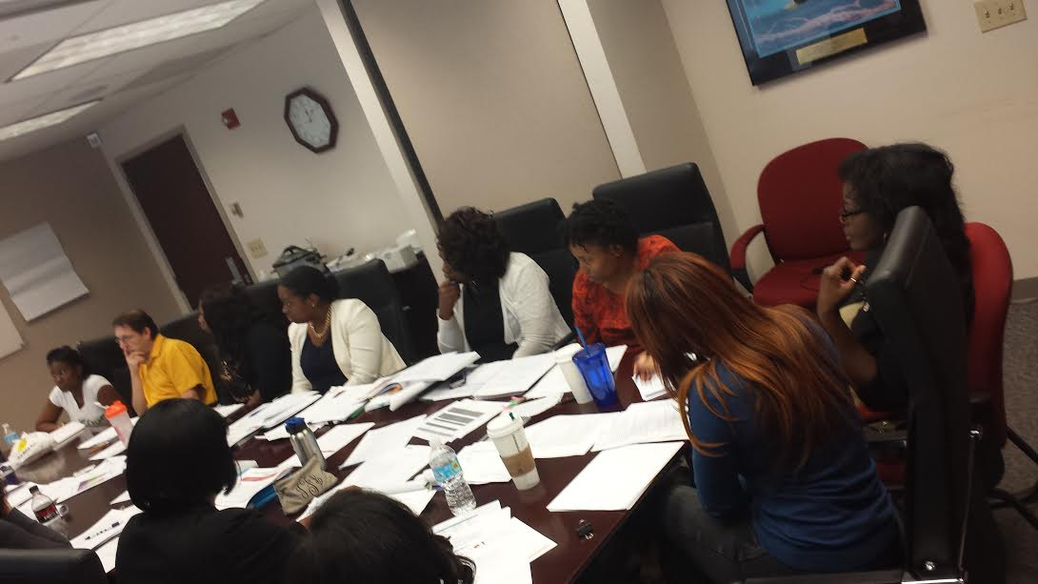
Monthly MCH Title V Work Group Meetings
MCH Directors & Managers
Notes:
The MCH Title V Work Group met to discuss strategies to conduct a state-wide 5 year needs assessment.

Slide 79
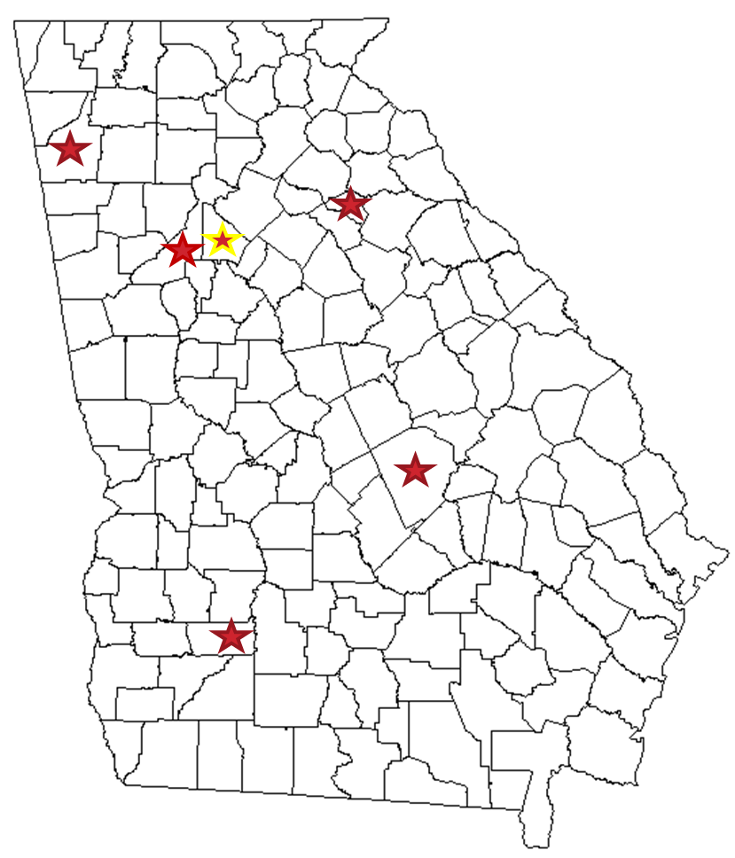
Perinatal Focus Groups
October 2014 – March 2015
Notes:
We ensured that the perinatal focus groups included women both under and over the age of 30. We also got Hispanic representation. Pregnant women or women that had a live birth in the past year.

Slide 80
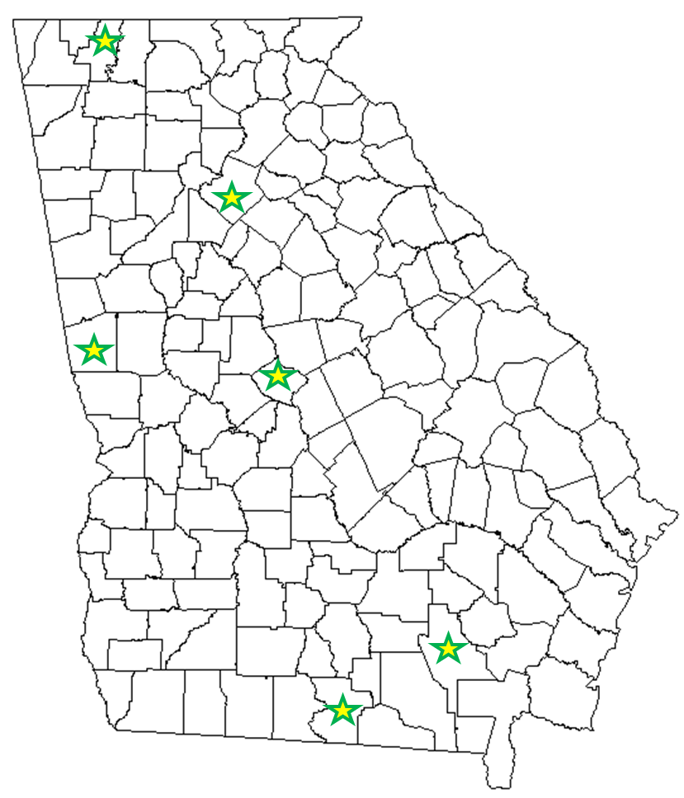
Readiness Focus Groups
October 2014 – March 2015
Notes:
Parents with children 4 to 7 years old.

Slide 81
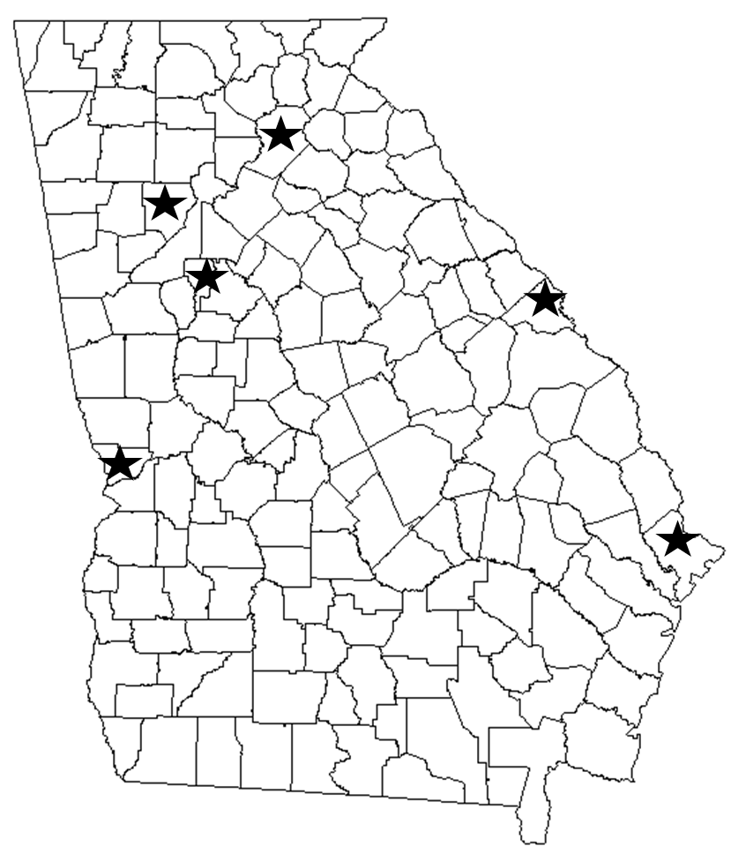
CYSHCN Focus Groups
October 2014 – March 2015
Notes:
We asked parents about CYSHCN 0-7 and 8+

Slide 82
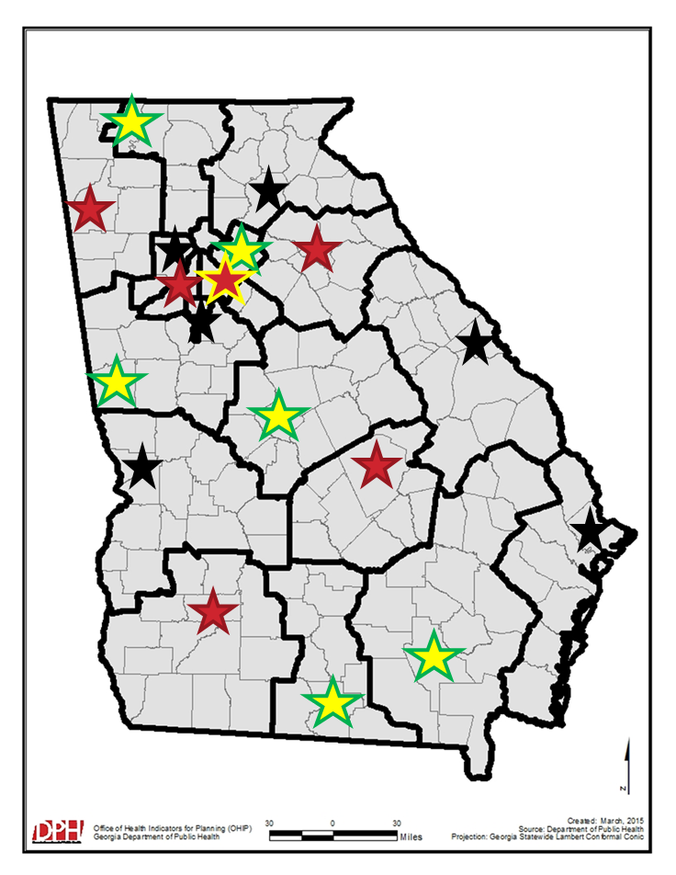
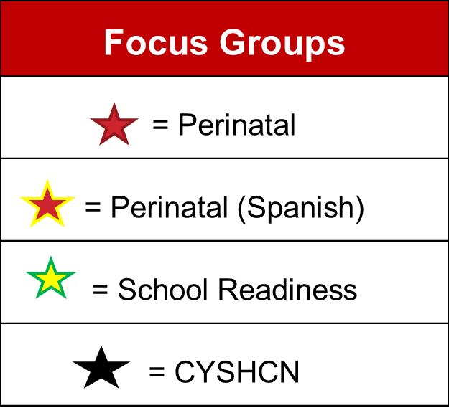
Focus Groups
October 2014 – March 2015
Notes:
We did 18 focus groups in each of the health districts and the topics varied across the state. There was 1 focus group in each district

Slide 83
Key Informant Interviews
March - April 2015
Purpose
  Identify needs and capture opinions from leaders that work closely with MCH
Target Participants
  Key leaders in programs that are not a part of DPH-MCH but work closely with MCH
Data Collection
  In-person or telephone interviews
Notes:
We are in the process of conducting key informant interviews to capture the opinions of leaders. Surveys rarely capture leaders opinions because they get delegated down. Examples of programs that we would like to do key informant interviews with would be injury prevention, adolescent health and district health directors.

Slide 84
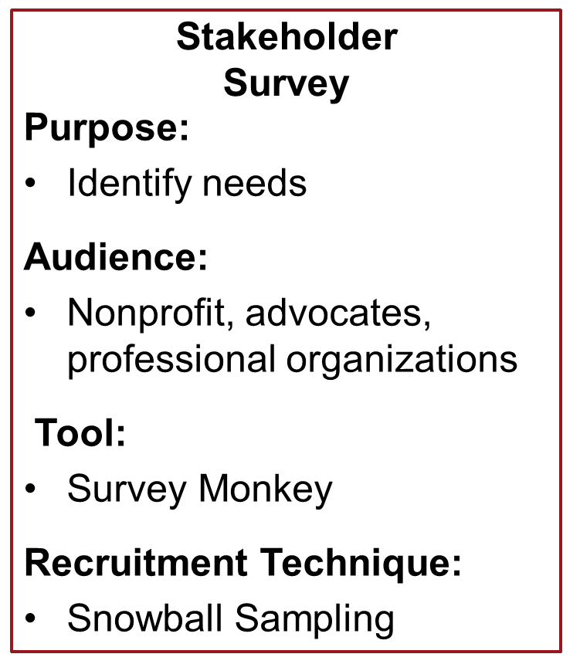
2 Surveys
March 2015
Public Health Worker Survey
Purpose:
Identify needs & capacity
Audience:
DPH-MCH State and District Employees
Tool:
Survey Monkey
Notes:
How long will it take someone to complete the survey?

Slide 85
What’s Next?

Slide 86
2015 National Priority Areas
Priority Area | Population Domain
Well-woman visit | Maternal/Women
Low-risk cesarean | Maternal/Women
Perinatal regionalization | Perinatal
Breastfeeding | Perinatal
Safe sleep | Perinatal
Developmental screening | Children
Injury | Children; Adolescent
Physical activity | Children; Adolescent
Adolescent well visit | Adolescent
Bullying | Adolescent
Medical home | CYSHCN
Transition | CYSHCN
Oral health | Cross-Cutting
Smoking | Cross-Cutting
Health insurance | Cross-Cutting
Notes:
This table shows the 15 National Priority Areas that were identified by the Maternal and Child Health Bureau (MCHB). Each National Priority Area is associated with National Performance Measure that states will report on for the next 5 years.
After looking at all the data and getting input from stakeholders, we will decide what our priorities should be. We can have up to 10 priority areas, but 8 must come from the list of National Priorities.

Slide 87
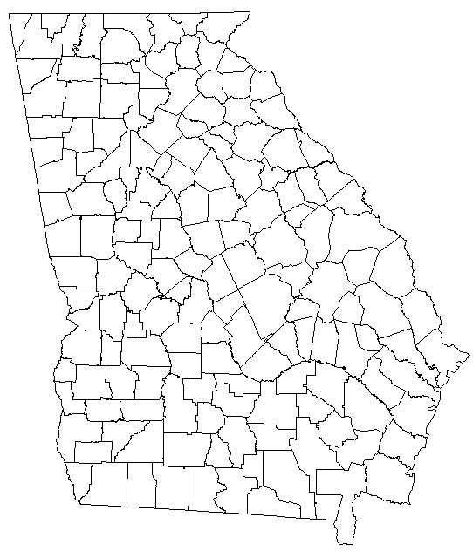
2 Stakeholder Meetings
May 4 and 5 : Valdosta, GA
May 7 and 8: Decatur, GA
Notes:
DPH will host two large meetings with stakeholders in May to learn about the findings and help us prioritize our priority areas.

Slide 88
How can you participate?

Slide 89
1
Annual Public Comment Period
  Late March
  Findings will be posted at www.dph.ga.gov/title-v
  Send comment/s to DPH-MCHEPI@dph.ga.gov
  with the subject “Title V Comments”
Stakeholder Survey
  March
  Katie Kopp will send e-mail to stakeholders
  Participate in the survey and share it with other stakeholders
2
Notes:
1. Our public comment period will be open soon and they will have the opportunity to comment. We will post documents throughout the spring, and they are able to comment on those documents, as well as what they think the priorities should be (Tiffany: make sure you do not directly ask them, just inform that we are accepting comments).
2. They can also participate in the Stakeholder Survey. We are trying a snowball approach with the survey. We want them to send it out to others.

Slide 90
Board Member Title V Toolkit
1
Title V Presentation
Title V Fact Sheet
Public Comment Schedule
2
3
Notes:
We need them to help us engage as many stakeholders as possible to participate in the survey and the public comment period as well.
First, you will see a presentation about Title V. We encourage you to use this as a tool to educate your staff about Title V.
2. Second, we have provided you with a Title V Fact Sheet. This factsheet provides basic information about Title V and we encourage you to disseminate among your staff and individuals within the community
3. Third, we have provided you with a Public Comment Schedule. This gives you a timeline and instructions on how to submit comments. We encourage you to disseminate this among your staff and individuals within the community

Slide 91

Acknowledgments
Dr. Seema Csukas – MCH Director
Katie Kopp – Title V Coordinator
Frederick Dobard – MCH Administrator
DPH Executive Leadership
MCH Office of Epidemiology
MCH Program Staff
DPH Board of Directors

Slide 92
Questions?

Slide 93
Closing Comments
Kathryn Cheek, MD, FAAP
Chair

Slide 94
The next Board of Public Health meeting is currently scheduled on
Tuesday, April 14, 2015 @ 1:00 PM.
To get added to the notification list for upcoming meetings, send an e-mail to huriyyah.lewis@dph.ga.gov

