Slide 1
STATE OFFICE OF VITAL RECORDS
NEW REGISTRAR ORIENTATION

Slide 2


Slide 3
Vital Records
MISSION
Create, maintain, protect, and provide access to vital event records in order to implement programs that promote health and well-being of Georgia constituents
VISION
To be known as an operationally excellent unit of DPH

Slide 4
Vital Records
GOALS
Build the Vital Records organization of the future
Work smarter
Shift the paradigm from a paper to an electronic record
Promote data integrity
High-grade the customer experience
Secure new revenue contracts

Slide 5
STATE OFFICE OF VITAL RECORDS
NEW REGISTRAR ORIENTATION
Constituent Services
Program Administration
Records Management
Data Integrity & Analytics

Slide 6
Constituent Services

Slide 7

Constituent Services
Overview
Responsible for ensuring that the Vital Records customer experience is excellent every time!

Slide 8
Constituent Services Functional Responsibilities
Walk-in Lobby
Low THC Oil Registry
Customer Satisfaction
Communications Center

Slide 9

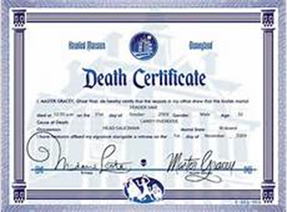
CONSTITUENT SERVICES
(Walk-in Lobby)
Respond to various VR customer requests such as:
  Copies of Birth Certificates
  Copies of Death Certificates
  Copies of Marriage Certificates
  Divorce Verifications
  Process Paternity Acknowledgements
  Name corrections/changes to Birth Certificates
  Court Orders
  Pen-in-Hand
  Other changes to vital records

Slide 10
Who can obtain a GA Birth Certificate?
511-3-33 Disclosure of Records:
  The registrant; or
  Either parent of the registrant listed on the certificate; or
  Registrant’s legal guardian; or
  Grandparent of the registrant; or
  Adult brother/sister of the registrant; or
  Adult child of the registrant; or
  Spouse of the Registrant; or
  Their legal representative

Slide 11
Birth/Death Certificate Issuance
Verify that the person was born or died in Georgia
2. Requestor must provide:
    Identification: Must have a valid ID (Review ID if walk-in customer, copy of ID if mail-in request)
    Relationship: Verify the relationship of the requestor to the person named on the certificate
    Cost: $25.00 to search for record ($5.00 for additional copies, if purchased during same transaction)
To process a birth or death request:
    Log into the GAVERS System
    Complete the required information
    Print the number of requested copies
    Birth certificate request – scan the barcode number on the security paper

Slide 12
Georgia Death Certificate Issuance
Death certificates with cause of death can be issued to:
  The spouse, children, parents, or other next of kin of the decedent or their respective legal representative; or
  When need for disclosure of the cause of death is necessary to establish a legal right or claim has been demonstrated; or
  Upon receipt of an order from a court of competent jurisdiction ordering such release.

Slide 13
Acceptable Photo Identification
Georgia Driver’s license unexpired or expired for not more than one year | U.S. Military Identification, Military Dependent Identification, Veteran’s Identification
State of Georgia Identification Card unexpired or expired for not more than one year | Unexpired Consulate Card
State of Georgia Weapons Carry License-NEW | Transportation ID
Unexpired driver’s license issued by another U.S. State, jurisdiction or territory | Debit Card with Picture
Unexpired official Identification Card issued by another U.S. State, jurisdiction or territory | Employer ID Card
Unexpired U.S. Passport | School, University, or College Identification Card
Unexpired Foreign Passport | DMV ID Card
Department of Corrections Identification Card
Please note that a voter registration card is no longer accepted.

Slide 14
Program Administration

Slide 15


Program Administration
Overview
Mission
To provide premier customer service, internal training, communications, and operational efficiencies, thereby adding value to the accomplishment of organizational goals.

Slide 16
Program Administration Functional Responsibilities
Policy & Training
Instructional Design:
Designs and develops instructor-led, web-based eLearning materials
Creates course manuals, training aids
Document training processes

Slide 17
Program Administration Functional Responsibilities
Compliance, Training & Communications
Compliance, training and support initiatives
Administrative reports and letters
Coordination of training logistics
Coordination of newsletter content/ VR Newsletter/Governance
Instructor led and web-based training to central office team
On-boarding of new employees
General VR communications

Slide 18
Program Administration Functional Responsibilities
Administrative Services:
Financial management
Contracts management
Procurement
Human Resources
Data requests management
Fiscal control, reporting, and procedures
Fee and mail room services

Slide 19

Security Paper/Web Enhancements

Slide 20
SECURITY PAPER FEATURES
(FRONT)
Top
Warning Band
Middle
Pantograph – 3 Color Iridescent Printing
“Void” Feature when copied
VOID

Slide 21
Security Paper Features
(Front)
Bottom
Inventory Control Bar Code
SEClipse – Yellow Dots
C – County Office
Borrowing is Prohibited
Thermochromatic Ink
GA Logo – Purple to Colorless
Embossed State of GA Seal
S – State Office

Slide 22
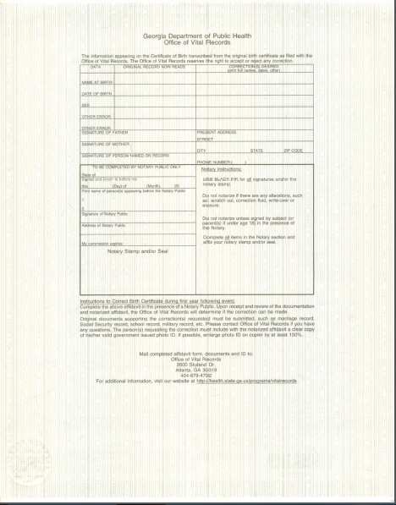
Security Paper Features
(Back)
Alpha Lines
Back
Certificate of Vital Record
Notes:
Verify Presence of Watermark – verify presence of watermark
Void appears when document is photocopied
Iridescent Printing – pink middle streak

Slide 23
Securing Your Security Paper
1. Must be stored within the vital records office
2. Must be stored in a locked file cabinet, closet, or safe
3. Must not be left in view of consumers or other passersby
4. Must use in the order in which it was received
5. Must arrange storage so that it is issued in numerical sequence
6. Must be protected at all times and access must be limited to only authorized persons.

Slide 24
Ordering Your Security Paper
Order Semi-annually or Annually
Cost - $11 per pack; $220 per box of 2000
Payment must be received prior to shipping
Mail payments to:
Georgia Department of Public Health
State Office of Vital Records
1680 Phoenix Blvd., Suite 100
Atlanta, GA 30349
Shipment mailed within 24 hours via UPS 2-Day Ground
To check the status of your order, send an email to vradminservices@dph.ga.gov.

Slide 25
Ordering Death Paper
IF IT’S PRINTED
30 Glenridge Drive
Newnan, Georgia 30265
Sean Milligan
770-253-1243
Ask for the Blue-Green Georgia
Basket Weave Death Paper

Slide 26
WEBSITE
Resource Area>Training Materials
  Registrars
  Birthing Centers
  Funeral Homes
Publications and Forms
  Vital Connections Newsletter
  Fillable PDF Format
Training Tools
  YouTube Channel Link
  Webinars

Slide 27
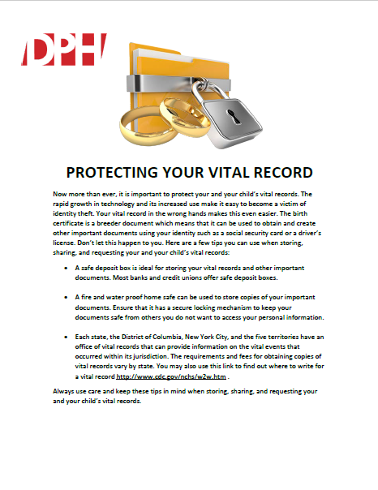
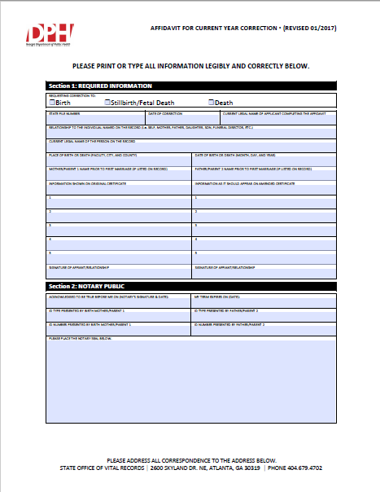

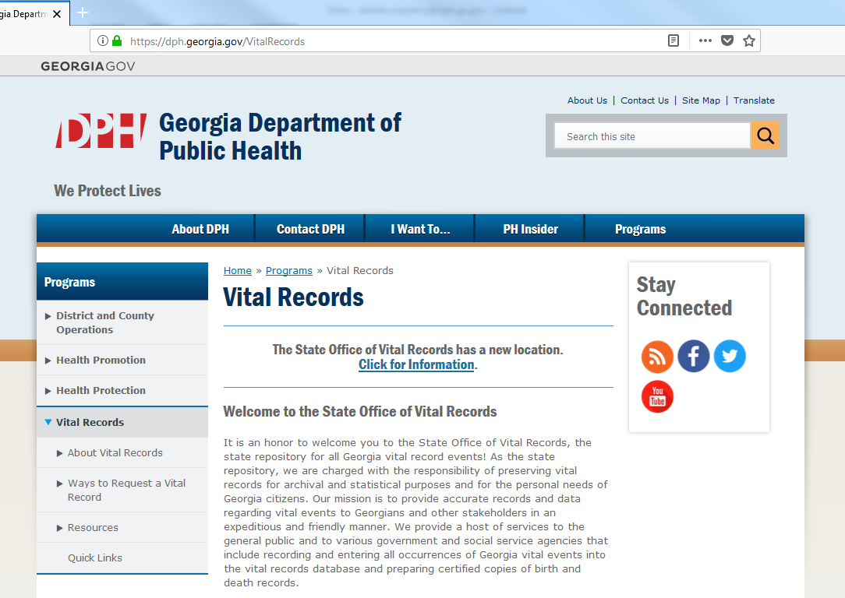
WEBSITE

Slide 28
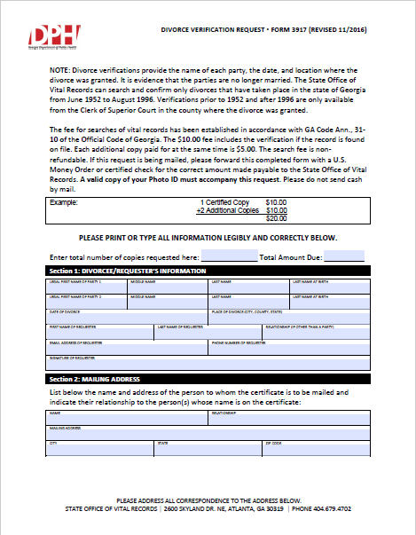
VR FORMS & DPH WEBSITE
To access the forms via the DPH website:
Open the browser of your choice.
Type dph.georgia.gov in the address bar.
On the main menu hover your mouse over programs.
Scroll down and select Vital Records.
On the left hand menu click the Resources tab.
Select forms under the resources menu.

Slide 29
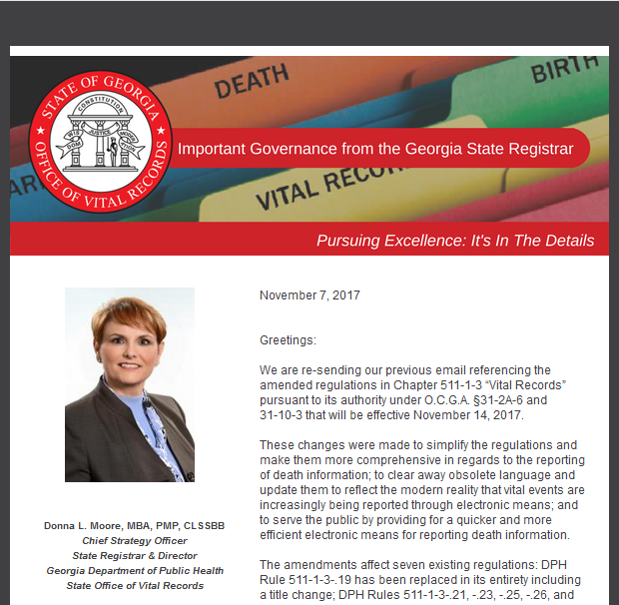
THE VITAL CONNECTION
Released around the 22th of each month
Posted to website under Vital News

Slide 30
Data Integrity and Analytics

Slide 31
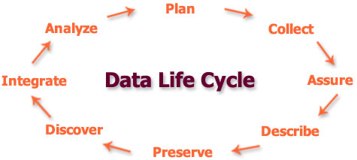
Data Integrity & Analytics
Overview
  Responsible for monitoring and maintaining data integrity; reporting vital records data; electronic exchange of data with outside agencies and partners.

Slide 32
Data Integrity & Analytics Functional Responsibilities
ZOHO Reporting
GAVERS State Employee Training
GTA Ticketing
Helpdesk
UAT Testing

Slide 33
Data Integrity & Analytics Functional Responsibilities
Death records to Social Security
Reporting of all Vital Events to the National Center for Health Statistics
Follow up with data providers on incomplete records
Infant Death Reporting Follow up

Slide 34
Data Integrity & Analytics Functional Responsibilities
VR tracking analysis and reporting
Key performance indicator score cards and reports
Project objectives and tasks
Program effectiveness
Vendors and internal client management
Program evaluations
Project scope, resource requirements, timeline deliverables, milestones

Slide 35
GAVERS
Georgia Vital Events Registration System

Slide 36
GAVERS
•Statewide system used for registering all vital events for the state of Georgia
•Approximately 3,000 users statewide
•Users contact the Operations Support Unit online and/or by phone for system assistance

Slide 37
GAVERS (OPERATIONS SUPPORT)
Receive calls and respond to help desk tickets from GAVERS users.
User Types:
-Funeral Homes
-Medical Facilities
-County Health Department /Probate Courts
-Individual customers

Slide 38
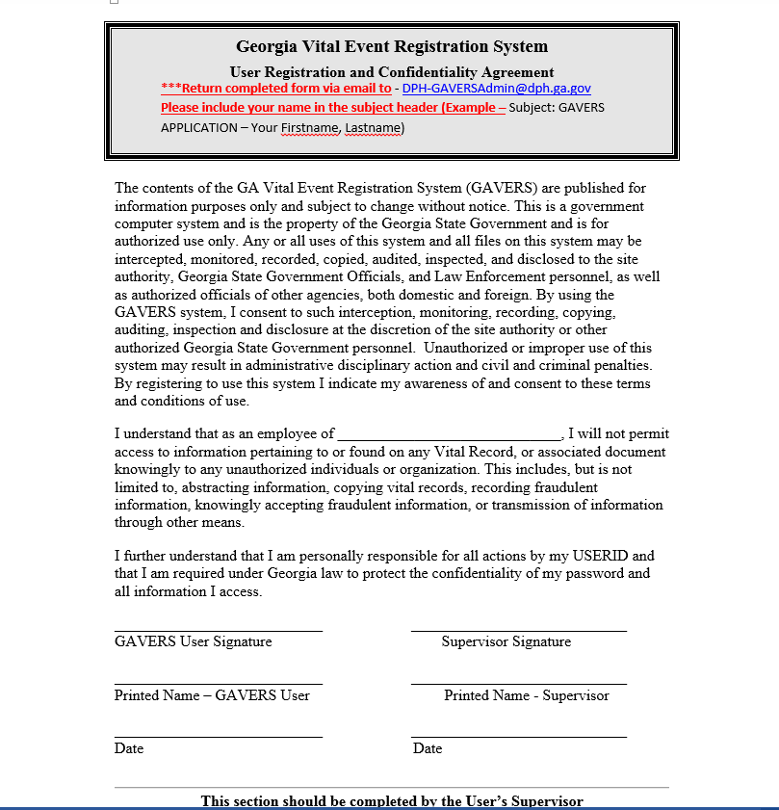

Slide 39
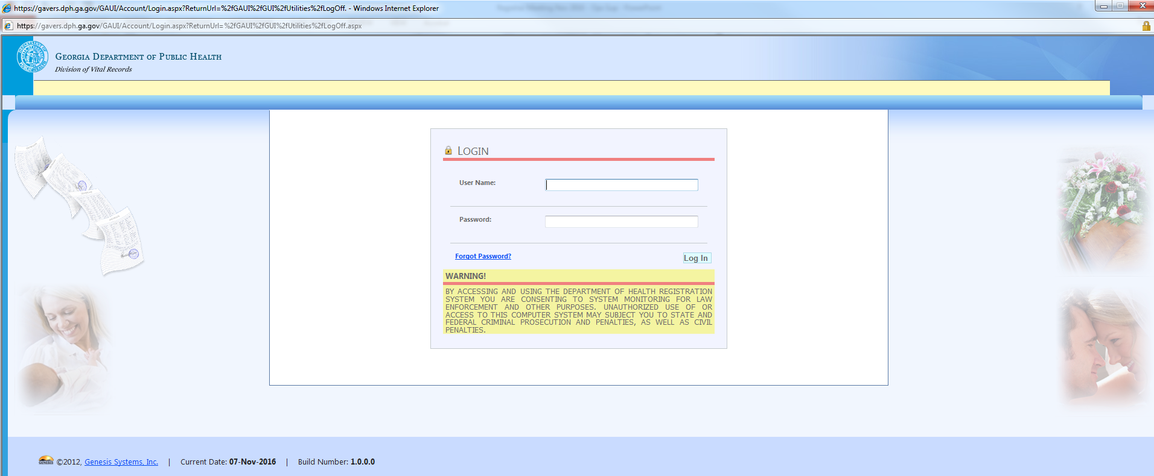

Slide 40
PASSWORD Rules
Must be at least 9 characters
Must contain at least 1 uppercase and lowercase letter
Must contain at least one special character (!#$@)
You will be prompted to change every 90 days
Do not share your password
Password Examples: SmokeyBear1@, Cl33nh@use

Slide 41
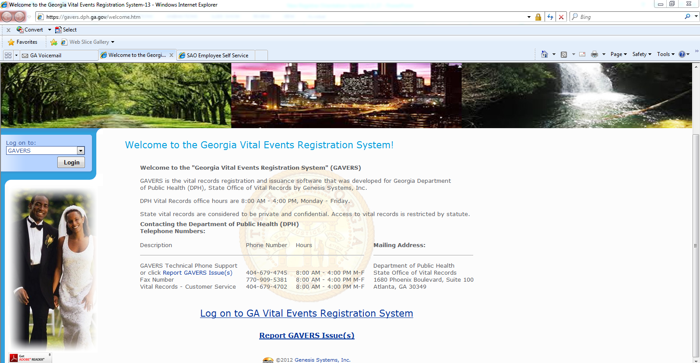

Slide 43
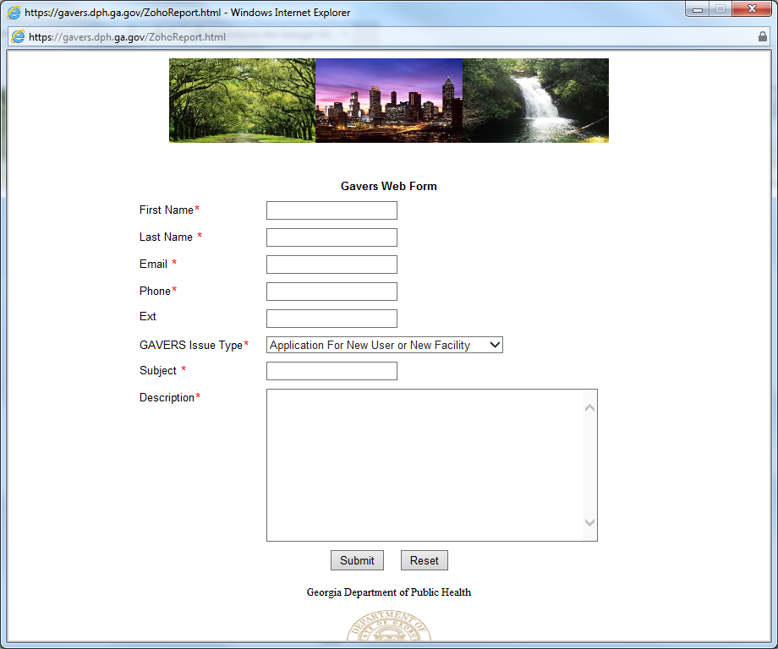

Slide 44
What Type Of Issue Should Not be Reported On-Line?
CORRECTION (Fax\Email\Mail-In Request)
AMENDMENT (Email\Mail-In Request)
Fax Number: 770-909-5381
Email: DPH-VRDEATH.CORRECTION@DPH.GA.GOV
(Requires Evidentiary Information and may take between 8 – 10 weeks to process)
Required Information:
Correct Name on Certificate:
Date of event (Birth or Death):
Court Documents (If applicable):
Mother’s Full Name (including maiden name):

Slide 45
Encrypted E-Mails
Why? – A temporary fix to speed up the response time
How? – You will receive the record via E-mail
What are the steps?
1. Download and open the attached file.
2. When your web browser opens click Use a one-time passcode.
3. An email will be sent to your inbox with the one-time passcode.
4. Minimize your web browser but Do Not Close it.

Slide 46
Encrypted E-Mails
5. Once the passcode has been retrieved return to your web browser and enter the Passcode you retrieved from your email.
Please note: the passcode will expire in 15 minutes.
6. After entering the passcode you will be redirected to the encrypted e-mail on your web browser

Slide 47
RECORDS MANAGEMENT
&
RETENTION

Slide 48

RECORDS MANAGEMENT
&
RETENTION
Responsible for providing direction, oversight and support to central office staff, county offices and local data partners (e.g., hospitals, doctors, coroners and funeral homes directors) to ensure the consistent and valid establishment, update, and maintenance of all Vital Records’ records and documentation.

Slide 49
Records Management & Retention Functional Responsibilities
Record Maintenance
Subpoenas
Secured Paper Issuance
Filing of Paternity Acknowledgements
Vault, Microfilm ( birth, death )
Digitization

Slide 50
Records Management & Retention Functional Responsibilities
Amendments
Special Services and Record Establishment
Death Correction
Court Order
Legitimation
Delayed Birth
Adoption
Court Ordered Petition

Slide 51
Records Management & Retention Functional Responsibilities
Amendments
Paternity Acknowledgement
Processing
ZOHO Abstraction
Putative Father Registry
Out of State Death Registration
Processing Death Registration
Fetal Death processing
ITOP processing
Home Birth Processing

Slide 52
Records Management & Retention Functional Responsibilities
Training and Support
Training and support of local constituents
Subject matter experts on Vital Records functions
Communicate policies to local constituents
Conduct regular reviews of local registrars

Slide 53
REGIONAL TRAINING & SUPPORT
The State supplies support to all County staff and stakeholders:
  Quarterly Registrar Meetings & Webinars
  Presentations/training at meetings and conferences
  Training and Support of local constituents
  Go To Meeting Training Sessions
  An operation support team that answers all issues through phone calls and when submitted through the GAVERS issue link
  Conduct regular reviews of local registrar office
  Communicate policies to local constituents

Slide 54
Regional Consultants
North : Justin.Davis@dph.ga.gov 404.414.9216
East: Cheryl.desbordes@dph.ga.gov404-956-0124
West : Mannett.Foster@dph.ga.gov 404.901.1634
South: Kamilah.Traylor@dph.ga.gov 404.901.1615

Slide 55
Death Worksheet

Slide 56
Entering a Death Record
The Death worksheet is divided into two portions: Demographic and Medical
Who enters what?
Demographic Portion
Funeral homes or a medical facility that is handling the disposition enters the demographic information.
Medical Portion
Medical facility, doctor’s office, coroner, or medical examiner (ME) enter the cause of death, injury information, if applicable, and certifier information.

Slide 57
CHAPTER 10 - VITAL RECORDS
§ 31-10-20
Permits for disposition, disinterment, and reinterment
(a) The funeral director or person acting as such or other person who first assumes custody of a dead body or fetus shall obtain a disposition permit for cremation or removal from the state. A disposition permit may be required within the state by local authorities.
(b) Such disposition permit shall be made available by the local registrar of the county where the death or fetal death occurred, or body or fetus was found, 24 hours a day, seven days a week. The registrar will issue a disposition permit immediately upon request from the licensed funeral director or his agent in charge of the body or fetus. The request for a disposition permit may be received by the registrar either orally or in writing. The registrar may respond to the request by any means utilized in the normal course of transacting business including, but not limited to, transmission by facsimile machine.

Slide 58
Annual Local County Vital Records Site
Assessment
The purpose of the visit is to perform a assessment of county offices, verify security measures, and to evaluate current practices and adherence to State Office policies.
The areas reviewed during the visit are:
Roles & Responsibilities Operations
Provision of Data and System Access
Original Records Held Locally
Registration of Death Records

Slide 59
Annual Local County Vital Records
Site Assessment
The areas reviewed during the visit are:
Issuance of Final Disposition Permits, Reinterment, Disinterment Issuance of Certificates
Issuance of White Copy Records
Confidentiality
Security & Fraud Prevention
Training

Slide 60
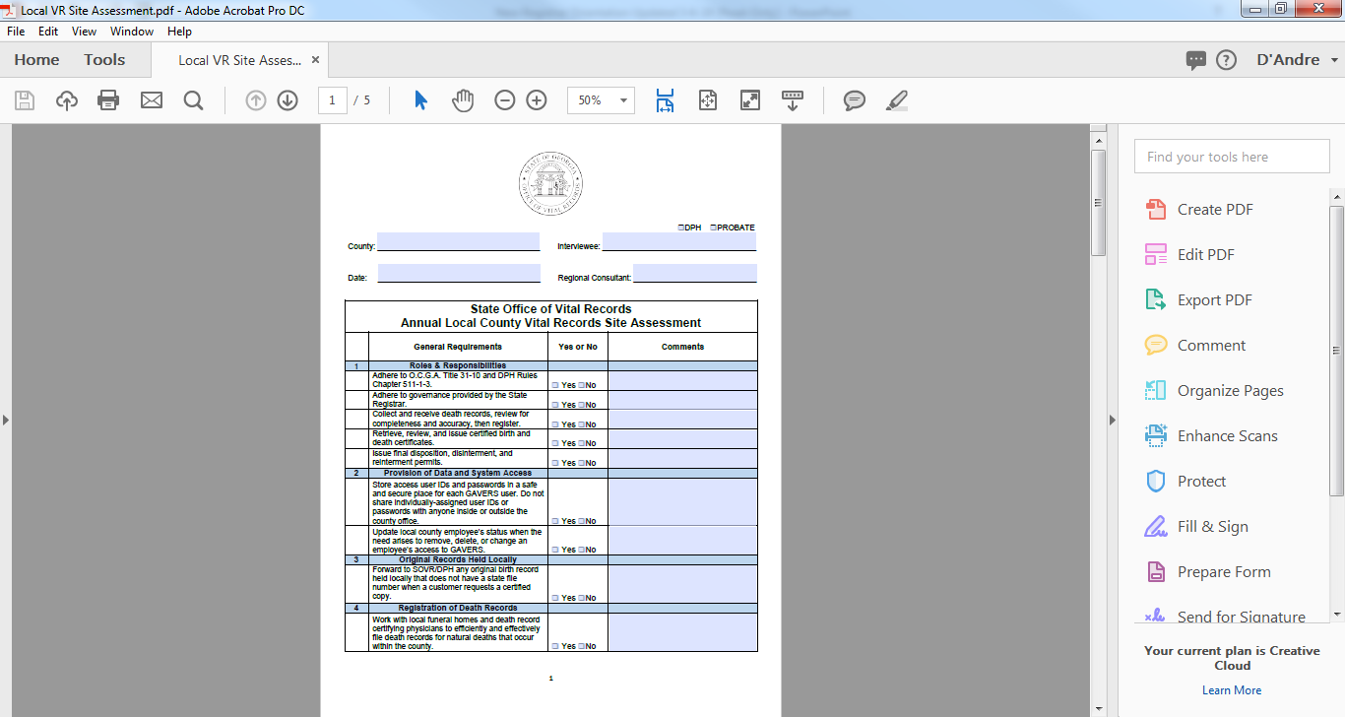

Slide 61
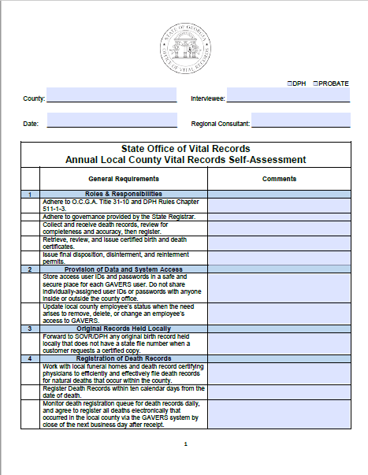

Slide 62

GAVERS MODULES PROJECT TIMELINE
DEATH
  BIRTH, FETAL DEATH, ITOP MODULE ROLLOUT
  JUNE 2014
BIRTH
FETAL DEATH
ITOP
  MARRIAGE/DIVORCE MODULE
  FEBRUARY 2015 (MARRIAGE ROLLED OUT)
MARRIAGE
DIVORCE
  FEE AND ISSUANCE MODULE 2018
FEE AND
ISSUANCE

Slide 63
Special Services Overview
Current Year Correction
Paternity Acknowledgement
Legitimation
Delayed Birth
Court Ordered Delayed
Court Order
Amendment
Out of Institution Birth

Slide 64
Current Year Correction

Slide 65
Current Year Correction
Amendments made within the first year of birth for the accuracy of information registered by the hospital at the time of birth.
These type of corrections do not change the format of the birth certificate.

Slide 66
Paternity Acknowledgement/Legitimation

Slide 67
Paternity Acknowledgement
Definition:
The Paternity Acknowledgement (PA) is used to add a biological (natural) father to a child’s birth record, and to initiate a parent-child relationship with legal responsibilities. This could also be the first step toward the legal process of Legitimation.
The Paternity Acknowledgement – Form 3940 (Rev 06/16) must be:
  Signed by both parents
  Notarized
  Filed with the State Office of Vital Records
VR Regulation 511-1-3-16

Slide 68
Paternity Acknowledgement
Parameters:
The mother must have given birth in the state of Georgia
The father self-acknowledges to be the child’s biological father
Both parents must sign the same PA form and is strictly voluntary
The PA cannot be used if the mother of the child was married to anyone within 10 months prior to the birth of the child or, if for any other reason, there is another father listed on the child’s birth certificate

Slide 69
Paternity Acknowledgement
A signed PA form allows:
The parents to name the child
The biological father’s name to be automatically added to a child’s birth certificate
The father’s name to be automatically added to the Putative Father Registry
Notes:
"Clarification: For a PA that will be signed at a later date after mom leaves the hospital, the unmarried parents will have the option to designate a new given name as well as surname, if they choose to by signing the PA.

Slide 70
Legitimation
At one time, for a child to be legitimated they had be born to parents that were married to each other at the time of the child's birth.
Legitimation gives the child the right to inherit from the father and the right for the father to inherit from the child, and the right for the father to petition the court for custody or visitation.

Slide 71
3 Type of Legitimations
Parent(s) Married
Parent(s) Married after birth of Child
Court Order Legitimation

Slide 72
Delayed Birth

Slide 73
What is a delayed birth?
Certificate of birth of a person born in the state of Georgia has not been filed before the person’s first birthday.

Slide 74
Delayed Birth
Documented evidence is required to show the registrant’s name, date of birth or age
All documents must show the date the original record was made and by whom
All original documents will be returned to the applicant upon review
Altered records or records which show incorrect information will not be accepted

Slide 75
COURT ORDERED
DELAYED BIRTH CERTIFICATE

Slide 76
Court Ordered Delayed
Birth Certificate
Court Ordered Delayed Births are required when the customers cannot produce the required records to file a delayed birth record.

Slide 77
Steps for filing the Court
Order Delay
Customer will receive from vital records clerk, a court order long letter, and court order Form No. 3948.
Customer MUST Petition the Judge in the State Judicial Court of GEORGIA, to establish a Court Ordered Delayed Birth Certificate.
Once the registrant receives the order, the order MUST be mailed to Vital Records for processing.

Slide 78
COURT ORDERS

Slide 79
Court Orders-Requirements
When registrant does not meet qualifications under O.C.G.A. 31-10 or VR Regs. 511-1-3.
Changing the year of birth by more than 1 year or past the file date
Changes after paternity acknowledgment has been filed
Changing the last name
Changing the pronunciation of the first or middle name or removing suffix

Slide 80
Court Orders-Requirements
Any change after a delayed birth certificate has been filed
Sex change
Legitimation
Changing an item more than once (vital records rules and regulations 511-1-3.29)
Changing the mother’s legal name on the child’s birth certificate

Slide 81
Court Order Format
Registrant’s name and date of birth at the time of birth
We cannot locate the birth certificate without it.
Any and all changes requested
We will only change the items listed in the court order.
Signature of the judge
Original court seal

Slide 82
AMENDMENT

Slide 83
Amendment
Any change made after the registrant’s 1st birthday
Transposition of letters in a name or changing the date of birth (Month, day or year)
Changing the date of birth prior to the filed date by no more than 1 year

Slide 84
Amendment
Correcting the parents name, date of birth, or place of birth (not to include certificates that were completed by Paternity Acknowledgments)
Error in gender mark
Time of birth, mother’s address, etc.

Slide 85
Out of Institution Birth

Slide 86
Out of Institution Birth
GA Law requires that you registrar your baby’s birth. A legal birth can only be created if the birth is registered.
Births occurring outside a hospital, or other recognized medical facility without medical attendance
The birth certificate is filed by someone other than a health care provider
Additional evidence in support of the facts of birth shall be completed and filed in the presence of the local Vital Records Registrar in the county where the birth occurred

Slide 87
Contacting the State Office
For help with an urgent customer matter:
  Contact Margaret Sparks at (770) 909-2945
For Other County Registrar needs:
State Office Communications Center
(404) 679-4702
  Select Option: 6 Local County Registrar
Gavers Help Desk – Operations Support
Regional Training Coordinator: Crystal Myers at crystal.myers@dph.ga.gov

