Slide 1
Paternity Acknowledgements,
Legitimations, and Rescissions
Donna L. Moore
State Registrar
Recorded 12/2016

Slide 2
Paternity Acknowledgement
The Paternity Acknowledgement (PA) is used to add a biological (natural) father to a child’s birth record.
The Paternity Acknowledgement – Form 3940
must be:
Signed by both parents
Notarized
Filed with the State Office of Vital Records
VR Regulation 511-1-3-16

Slide 3
Paternity Acknowledgement
A signed PA form allows:
The parents to name the child
The biological father’s name to be automatically added to a child’s birth certificate
The father’s name to be automatically added to the Putative Father Registry
Notes:
"Clarification: For a PA that will be signed at a later date after mom leaves the hospital, the unmarried parents will have the option to designate a new given name as well as surname, if they choose to by signing the PA.

Slide 4
Paternity Acknowledgement
Parameters:
The mother must have given birth in the state of Georgia
The father self-acknowledges to be the child’s biological father
Both parents must sign the same PA form and is strictly voluntary
The PA cannot be used if the mother of the child was married to anyone within 10 months prior to the birth of this child or, if for any other reason, there is another father listed on this child’s birth certificate
Notes:
Although this is not written in the Regulations about the parental information, the back of the form says, “Any changes made to the birth record in the future regarding the child’s name, mother’s name or father’s name will require a court order.”

Slide 5
Paternity Acknowledgement
PA - Child under 1 year old
PA - Child over 1 year old
511-1-3-.27(1) Until the registrant’s first birthday, given names may be added to, changed, or corrected upon receipt of an affidavit signed by; (a) Both parents; or (b) The mother of a child born out of wedlock; or (c) Either parent in the case of the death or incapacity of the other; or (d) The legal guardian or agency having legal custody of the registrant.
511-1-3-.27 (2) When a paternity affidavit has been completed and filed, no further amendment to the child’s name shall be made except upon receipt of an order from an appropriate court, or if the natural parents marry after the birth of the child and thereby legitimate the child.
511-1-3-.27 (3) After one year from the date of birth, the provisions of Rules 511-1-3-.25 and 511-1-3-.10 must be followed to add a given name omitted on the birth certificate, or to amend a given name if the name was misspelled on the birth certificate. The State Registrar may change a given name after one year only upon receipt of an order from a court of competent jurisdiction requiring such change.
511-1-3-.25 speaks on the amendment process

Slide 6
PA: July 1, 2016 Changes
Governor Deal signed SB64 into law in April; effective July 1
Major changes
Can no longer do a voluntary legitimation; must be a court-ordered legitimation OR dad must marry mom and recognizes child as his own
PA form 3940 changed
Posted on the VR website
Previous versions not acceptable
PA form must be filed with the State Office within 30 days of execution/signature date

Slide 7
PA: July 1, 2016 Changes
After the document is filed, the following persons can request a certified copy from the State Office:
Any person who signed it
The guardian or temporary representative of any person who signed it
The child if he or she is at least 18 years old
The guardian, temporary guardian, or legal custodian of the child
The child’s living legal spouse, next of kin, legal representative, or someone who has applied in good faith to become the child’s legal representative
A government agency who needs it for official purposes
In response to a court order or subpoena
An attorney licensed in GA who needs it for purposes of legal investigation on behalf of a client
A licensed child placement agency that needs it for official purposes

Slide 8
Requirement vs Practice
The PA statute does not require a parent/legal guardian of a minor to sign the form. Yet, there are plenty of other statutes in the Georgia Code that require parental consent with regard to minors.
Parental consent for minors is requested on the new form as a matter of practice and procedure, not a matter of law or regulation
The “age of majority” in Georgia is eighteen.
Contracts signed by a minor are voidable at the minor’s election, but not void. Code Sections 13-3-20, 13-5-3, 44-5-41.
A minor’s signature on a PA is susceptible to legal challenge. As a practical matter, what we gain from the parental co-signature is that it makes it harder for the minor (or anyone else) to argue that the minor didn’t know what they were signing.
An unwed parent under the age of 18 may sign without parental consent if he/she is on active duty with the military, or emancipation has been granted by a court order
Laws in other states are all over the board. North Dakota and Florida allow minors to sign PAs, though the Florida Department of Health “encourages” parents to countersign. New York does not allow minors to sign a PA.

Slide 9
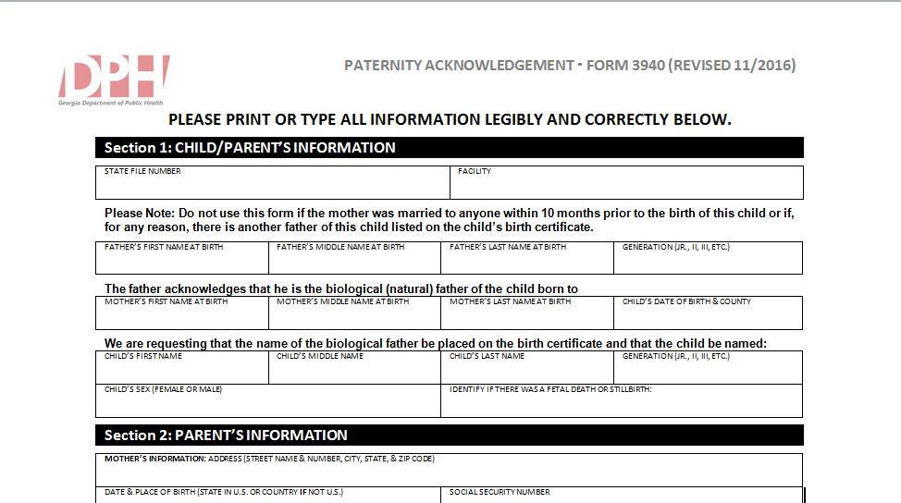
Notes:
GIVE SPECIAL ATTENTON TO: Child's given name at birth, Child to be named, and Notary signature and Date.
"Clarification: For a PA that will be signed at a later date after mom leaves the hospital, the unmarried parents will have the option to designate a new given name as well as surname, if they choose to by signing the PA.
Although this is not written in the Regulations about the parental information, the back of the form says, “Any changes made to the birth record in the future regarding the child’s name, mother’s name or father’s name will require a court order.”

Slide 11
Legitimation
Parameters
To carry out the provisions to amend the birth certificate, a certified copy of the parents’ marriage record and an affidavit of both parents are required.
If the mother or the putative father is deceased at the time an application for amendment of the birth certificate is made, a court order from a court of competent jurisdiction(Superior Court) is required.
If another person is shown as the father of the child on the original certificate, or the birth certificate reflects that the natural mother was married at the time of conception, birth, or any time between conception and birth, a Superior court order is required. Such court order must specify the name to be removed and the name to be added as father of the child.
Notes:
To carry out the provisions to amend the birth certificate, a certified copy of the parents’ marriage record and an affidavit signed by the natural parents are required.

Slide 12
Legitimation: July 1, 2016 Changes
After July 1, 2016, legitimation of babies born out of wedlock can be accomplished only
by court order, or
if dad marries mom and “recognizes such child as his own”
Voluntary acknowledgements of legitimation which were signed on or before June 30, 2016 are valid and will be accepted.

Slide 13
PAs & Legitimations are de facto Amendments
Upon amendment of an item in a vital record, that item shall not be amended again except upon receipt of a court order from a court of competent jurisdiction.
VR Regulation 511-1-3-.29
A paternity affidavit and a legitimation affidavit shall be considered to be an amendment; therefore, once a paternity affidavit or legitimation affidavit has been completed and filed, no further correction of the child’s name shall be made except upon receipt of an order from a court of competent jurisdiction
13

Slide 14
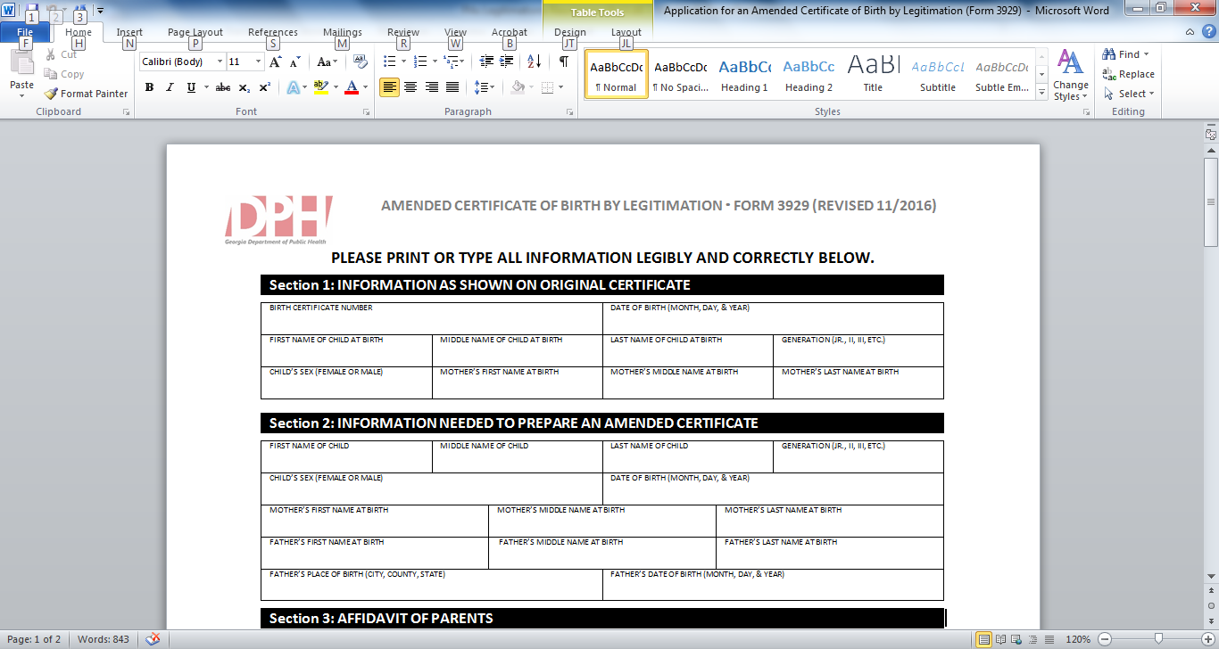
14

Slide 15
Rescission
Either the mother or biological father has 60 days from the date of his/her signature to request to rescind a Paternity Acknowledgement. Form 3956
Rescission of this document will rescind the PA, but will not remove the father from the birth certificate.
A court order must be obtained to remove the father from the birth certificate or make further amendments.
After the 60 day rescission period has ended, this signed document may constitute a legal determination of paternity and can only be challenged in a court of law on the basis of fraud, duress, or material mistake of fact, with the burden of proof on the person challenging the acknowledgement.
Notes:
Parents may obtain a rescission form From the State Office of Vital Records, local Vital Records Offices, and Probate Court Offices. (The form will also be made available on our website and via the GAVERS system. )

Slide 16
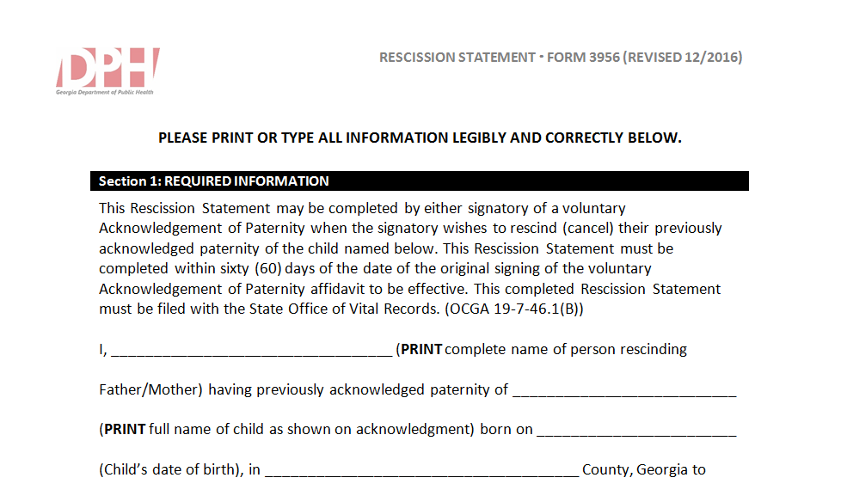

Slide 17
Questions?

