Slide 1
Georgia Gateway Updates
Nutrition Services Directors
Sonia Jackson, Sid Peechagardi, Anthony McGaughey
September 7, 2017

Slide 2
Overview
Provide updates on the Georgia Gateway system
Define new code changes in the Georgia Gateway system
Discuss upcoming events
Discuss comments, suggestions, and feedback regarding the Georgia Gateway system

Slide 3
Gateway Updates
Notes:
Sid Please provide your updates on theses slides

Slide 4
Gateway Updates - Where Are We Now?
Wave 1 rollout began May 1, 2017
Wave 2A rollout began July 10, 2017
Connectivity issues using VPN and State Circuit
Gaps related to the delay in SOG/Gateway access
Wave 2B will begin rollout on September 5, 2017
Notes:
Sid continue updates

Slide 5
Gateway Updates - Where Are We Now?" (cont.)
All districts have completed training on Gateway
Gateway training and Sandbox environments are stable; apart from a few isolated incidents of login issues
Conversion should be complete with the Wave 2B rollout (participants information should be in converted status)
Deloitte Field Support and Virtual Helpdesk ends Oct 5th, 2017
Notes:
Sid continue updates

Slide 6
Gateway Updates - Where Are We Now?" (cont.)
Changes Requests:
In Production:
- New WIC Income Guidelines implemented on July 1, 2017
Addition of Gateway office number and source of application
implemented on Aug 19, 2017
Upcoming:
- Changes to the WIC driver flow in Gateway
- Changes and Renewals for WIC
- Adjunctive Eligibility for WIC
Notes:
Sid continue updates

Slide 7
USDA Site Visits
USDA SERO visited Henry County WIC on June 15, 2017, to observe Georgia Gateway in action and the intake process. The SERO staff was very impressed with the system and its functions. They praised our training and staggered rollout schedules.
USDA National State Systems Office (SSO) Director, Mark Barner and Kathy Tankersley, visited Henry County WIC on August 23, 2017, to observe Gateway. They observed the system in the DFACS office and we reviewed our training and implementation procedures. A copy of Gateway outreach materials and the training manual was also provided.

Slide 8
Lessons Learned from Wave 2A
Nancy Jeffery, MPH, RD, LD - Macon
Teresa Graham, MPA, RD, LD, CLC - Albany

Slide 9
Open Forum
Opening of the Customer Portal
Change Champion Activities – Related Updates
Pending WIC Applications
Notes:
Sid continue updates

Slide 10
Withdrawing an Application

Slide 11
Withdrawing an Application (cont.)

Slide 12
New WIC Codes for Gateway
Notes:
Wave 2 requested specific conversation about adding and searching documents. Therefore, we are going to go over some steps on how to do so.

Slide 13
New Gateway /WIC Codes Residency
Gateway Code | Documentation | FES receive code as
AV | Requires Additional Verification | AV-30 Day
CS | Client Statement | CS- No Proof
CV | Conversion | ZZ-Need Correct Code
DL | Driver’s License | DL
LS | Landlord Statement | LS
ML | Mortgage/Lease Statement | ML
OT | Other Acceptable Verification | OT
UB | Utility Bill (Any Bill) | UB
VT | Voter Registration Card | VT

Slide 14
New Gateway/WIC Codes Identity
Gateway Code | Documentation | FES receive code as
AC | Alien Card | AC
AV | Requires Additional Verification | AV- 30 Day
BC | Birth Certificate | BC
CC | Certificate of Citizenship | CC
CI | Corrections ID | CI
CS | Client Statement | CS- No Proof
CV | Conversion | ZZ-Need Correct Code
DL | Driver's License | DL
DC | Declaration of Citizenship (MA Only) | ZZ-Need correct Code
EA | Employment Authorization Document | ZZ-Need Correct Code
FS | Federal, State or Local Government ID Card | FS
HS | Hospital Record | HS
IR | Immunization Record | IR
I9 | I-94 | ZZ-Need Correct Code
MD | Military ID Card/Record | MD
MR | Medicare Recipient/Entitled | ZZ-Need Correct Code
NC | Naturalization Certificate | NC
OT | Other Acceptable Verification | OT
SI | School record including report card, day care or nursery school record | SI
TV | Trafficking Victim Certification Letter | ZZ- Need Correct Code
UP | US Passport | UP
VR | Voter Registration Card | VR
WI | Work ID | WI

Slide 15
New Gateway/WIC Codes Income
Gateway Code | Documentation | FES receive code as
21 | MA/FS/TF Adjunctive Eligibility | GG
AL | Award Letter | AL
AV | Requires Additional Verification | AV-30 Day
BR | Business Records | BR
BX | Electronically verified by BENDEX | BX
CK | Check Stubs | CK
CS | Client Statement | CS
CV | Conversion | ZZ- Need Correct Code
DL | Electronically verified by DOL | DL
FD | Electronically verified by FDSH | FD
HC | Letter | HC
MT | Multiple Sources of Income/Not Adjunctively Eligible | MT- Multiple Incomes Used
OT | Other Acceptable Verification | OT
PS | Pay Stubs | PS
RC | Receipts | RC
SS | Social Security Records | SS
SV | Electronically verified by SVES | SV
SX | Electronically verified by SDX | SX
TR | Tax Return | TR
WC | Workers Compensation | WC
WF | Wage Form | WF
WN | Electronically verified by work number | WN

Slide 16
Next Steps for Training and Implementation
Districts must ensure that all training sign-in sheets were submitted:
To Sid Peecharagadi and Sonia Jackson
Ensure all current and ongoing Social Security Administration (SSA) Rules of Behavior Form training are submitted:
To Jehan Bostick
Note: The SSA Security Training and Rules of Behavior Form will be required annually.
Notes:
Sonia: Reference Gateway Security & Confidentiality Form

Slide 17
Action Steps
Finalizing the following:
Secure SOG log-ins for staff
Ensure staff are continuing to “play” in Sandbox environment to become comfortable with system

Slide 18
Summary
Wave 2B scheduled rollout is September 5, 2017.
New verification codes were implemented July 10, 2017.
Complete SSA Confidentiality Annual Training and submit required forms upon completion.
All pending application in application inbox must be completed or withdrawn by end of each week.

Slide 19
What questions do you have?

Slide 20
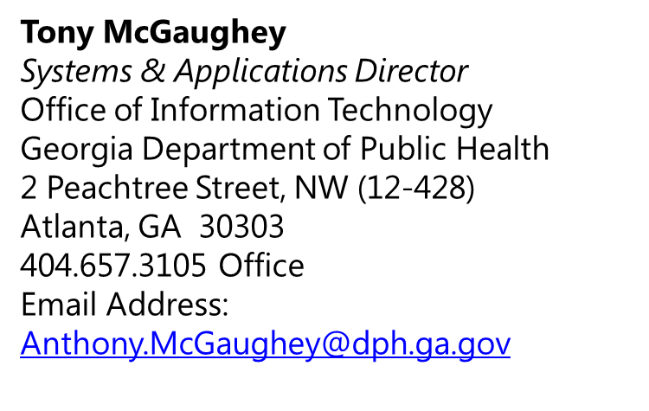
Contact Information
Sid Peecharagadi PMP®
Sr. Project Manager – GA Gateway WIC
Georgia Department of Public Health
2 Peachtree St NE (10-405)
Atlanta, GA 30303
Mobile: 404 408 8644
Email Address: Sid.Peecharagadi@dph.ga.gov

