Slide 1
Safe Infant Sleep – Special Considerations
WIC Educators
Terri Miller, MPH, CHES
June 27, 2017

Slide 2
Overview
Brief background
Georgia Data
Special Considerations
  Room sharing
  Falling asleep while feeding
  Swaddling
  Pacifiers
  Reflux

Slide 3
What is Safe Sleep for Babies?
Notes:
In 1992, the American Academy of Pediatrics (AAP) issued its first recommendation on infant sleep which was to place infants on their back (supine) or on their side. Until this time, there was no consistent recommendation rooted in science and based upon research.
In 1994 the National Institute on Child Health and Development launched the “Back to Sleep” Campaign. This campaign was very successful and resulted in a large number of children being placed either on their back or side for sleep. The result was a dramatic drop in SIDS (Sudden Infant Death Syndrome) related deaths.
In 2005, the AAP changed its recommendation from supine or side, to supine only. It eliminated any recommendation of side sleeping for healthy infants.
In 2011, the AAP further expanded their recommendations on infant safe sleep to include the sleep environment because unfortunately, at the same time that SIDS rates were declining it was discovered that SUID (Sudden Unexpected Infant Death) rates were increasing. Many past SIDS cases are now believed to have been SUID. SUID cases often involve unsafe sleeping environments and one or more risk factors for SIDS; therefore, infant safe sleep must incorporate not only the sleep position but also the sleep location and environment.

Slide 4
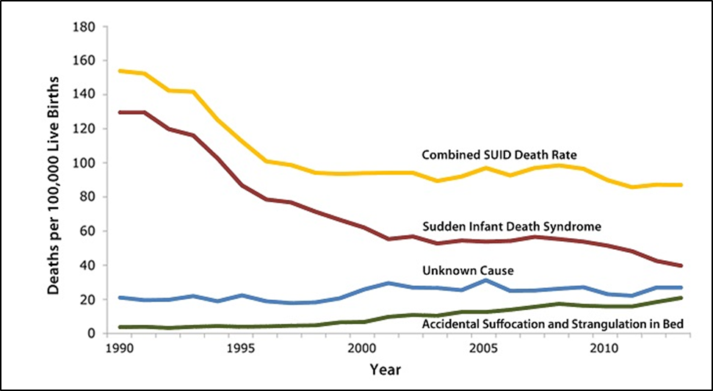
Trend Over Time

Slide 5

Georgia Facts
As of 2015, Georgia averaged
3 infant deaths per week
due to sleep-related causes.
The majority of these deaths were
preventable.

Slide 6
Terms
Sudden Infant Death Syndrome (SIDS): Sudden, unexplained death of a baby younger than one (1) year of age that does not have a known cause after a complete investigation (complete autopsy, examination of the death scene, and review of the clinical history).
Sudden Unexplained Infant Death (SUID): Death of an infant less than one year of age that occurs suddenly and unexpectedly. After a full investigation, these deaths may be diagnosed as suffocation, asphyxia, entrapment, infection, ingestions, metabolic diseases, cardiac arrhythmias, trauma (accidental or non-accidental), or SIDS.
In some cases—where the evidence is not clear or not enough information is available—the death is considered to be of an undetermined cause.
Notes:
Read the definitions
The terminology around sleep-related deaths can be confusing. In the past, all cases were classified as SIDS, because that was our only term to use for the unexpected and unexplained death of an otherwise healthy infant. As our surveillance and investigation techniques improved, it was discovered that many of these deaths could actually be attributed to other causes. SUID was developed to encompass these deaths and although the causes of death in many of these children can’t be fully explained, most do occur while the infant is sleeping in an unsafe sleeping environment.
The difficulty in clearly defining the deaths includes the fact that often, no one sees these deaths, and there are no tests to tell sudden infant death syndrome (SIDS) apart from suffocation. To complicate matters more, people who investigate sleep-related deaths may report cause of death in different ways and may not include enough information about the circumstances of the event from the death scene.
Despite all of this confusion around terminology, we do know a lot about the risk factors involved with all sleep-related deaths so, lets talk more about these factors.

Slide 7
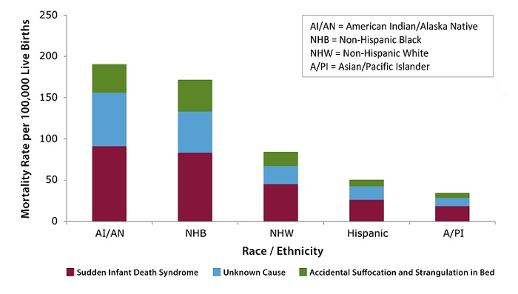
Demographics/Equity
SOURCE: CDC/NCHS National Vital Statistics System, Period Linked Birth/Infant Death Data
Notes:
This is data from the CDC and, while sleep-related infant deaths can happen to anyone, African American and Native American babies have a rate that is 2x higher than other races and ethnicities. Georgia death data follows this path as well.

Slide 8
Notes:
This data is from the Georgia Child Fatality Review from 2009-2013. Over this 5 year time frame, we see that the vast majority of sleep-related infant deaths occurred within the adult bed. It’s rather compelling to see that out of 785 deaths, 405, or 52%, occurred within the adult bed. This doesn’t tell us if the child was alone in the bed, sharing with an adult caregiver or even, sharing with a sibling. We just know that the infant was found deceased in an adult bed.
The first instinct when we see this chart is to automatically want to just tell people to not bed share. A valid recommendation however, how do we address the fact that the 2nd highest location is the crib?....18% of the deceased infants were found in the crib. As we continue down the list we also see couch, bassinet, playpen, car seat and so on, as other locations. We do a disservice to our parents and infants by simplifying the message too much. Safe infant Sleep involves not just the sleep location but also, the sleep position, and environment. Which we will learn more about in the following slides.

Slide 9
Sleep-Related Deaths by Age in Months,
GA, 2014, n=158
90% of infant sleep-related deaths occur prior to 6 months of age.
Source: GA Child Fatality Review File, 2014
Notes:
Here we see data from the GA Death Certificate File– and this shows the infants age, by month, at the time of death.
1 - First, please note the drastic drop in deaths at 3 months going into 4 months. In 2014, 81% of our sleep-related deaths occurred prior to 5 months of age and a full, 89% occurred prior to 7 months of age. If you think about that for a moment, 3 babies a week die from sleep-related causes, and of those, 89% occur within the first 6 months of life.
2 – Researchers looked into the deaths occurring later around 7 to 8 months. They found that strangulation and suffocation were largely the identified causes of death in these older children. It is hypothesized that the child is more mobile and therefore, better able to “get into things” such as monitor cords, crib bumper ties, etc. We focus the bulk of our attention on those early months because on the high number of deaths and the vulnerable nature of the infant however, it’s good to keep in mind that older children still face a risk as well.

Slide 10

Georgia Safe to Sleep Campaign
  Provides tools and resources that strengthen policy, provide consistent education and change infant sleep environments to:
    Prevent infant sleep-related deaths in Georgia
    Empower professionals to educate parents
    Empower families to make informed decisions about infant sleep
    Increase access to resources that support behaviors that protect infants from sleep-related deaths
    Promote ABCs of Safe to Sleep
      Alone - in their own sleep space
      Back- on their back, every sleep, every nap, every time
      Crib - in a crib or bassinet with a firm, flat surface

Slide 11




My Baby Sleeps Safe –
Please follow these guidelines.
Alone – My baby should always have his or her own safe sleep space. Close by, but separate. No sharing of the sleep space with others, including children.
Back – My baby is placed on his or her back for every sleep, every time, even naps.
Crib – My baby needs a crib without blankets, quilts, crib bumpers or other items. Please no couches or adult beds.
For more Information on Safe Sleep for Babies – visit www.dph.ga.gov/safetosleep
Notes:
As educators, our understanding of safe infant sleep needs to be a little more in-depth. However, for parents– the Safe to Sleep guidelines are really very simple. A – B – C. (read through the slide) This is meant to be an easy way to remember the primary recommendations while also allowing the parent to evaluate their babies sleep environment, no matter how it might change.
How well are these recommendations currently being followed? PRAMS data from survey’s conducted in Georgia from 2009-2012 found that less than ½ of new moms reported that their babies slept on their backs most of the time. Additionally, ½ of new mom’s also reported bed sharing.
***The Pregnancy Risk Assessment Monitoring System (PRAMS) is a statewide, ongoing, population-based survey that collects information on women who give birth in Georgia. GA PRAMS began in January 1993 and it supplements birth certificate data by collecting information on women's attitudes, experiences, and behaviors before, during, and after they deliver a live born infant.

Slide 12
2016 American Academy of Pediatrics Safe Infant Sleep Recommendations
Level A Recommendations:
  Back to sleep for every sleep.
  Use a firm sleep surface.
  Breastfeeding is recommended.
  Room-sharing with the infant on a separate sleep surface is recommended.
  Keep soft objects and loose bedding away from the infant’s sleep area.
  Consider offering a pacifier at naptime and bedtime.
  Avoid smoke exposure during pregnancy and after birth.
  Avoid alcohol and illicit drug use during pregnancy and after birth.
  Avoid overheating.
  Pregnant women should seek and obtain regular prenatal care.
  Infants should be immunized in accordance with American Academy of Pediatrics and Centers for Disease Control recommendations.
Notes:
Do not use home cardiorespiratory monitors as a strategy to reduce the risk of SIDS.
Health care providers, staff in newborn nurseries and NICUs, and child care providers should endorse
and model the SIDS risk-reduction recommendations from birth.
Media and manufacturers should follow safe sleep guidelines in their messaging and advertising.
Continue the “Safe to Sleep” campaign, focusing on ways to reduce the risk of all sleep-related infant
deaths, including SIDS, suffocation, and other unintentional deaths. Pediatricians and other primary
care providers should actively participate in this campaign.

Slide 13
2016 American Academy of Pediatrics Safe Infant Sleep Recommendations (cont.)
Level B Recommendations
  Avoid the use of commercial devices that are inconsistent with safe sleep recommendations.
  Supervised, awake tummy time is recommended to facilitate development and to minimize development of positional plagiocephaly.
Level C Recommendations
  Continue research and surveillance on the risk factors, causes, and pathophysiologic mechanisms of SIDS and other sleep-related infant deaths, with the ultimate goal of eliminating these deaths entirely.
  There is no evidence to recommend swaddling as a strategy to reduce the risk of SIDS.

Slide 14
Risk Reduction Model
Increasing Protection (Reducing risk)
Reducing protection (Increasing risk)
Unsafe
Safe
Risk reduction is a behavioral change concept.
Individuals make their own choices about what they are willing/able to change.
Informed choice is our goal.
Notes:
In other words, we are working to “increase the protection” of infants by giving caregivers the opportunity to make an informed choice about how their baby will sleep. Can we move them along the continuum of risk to get them closer to the most protected environment for baby?

Slide 15
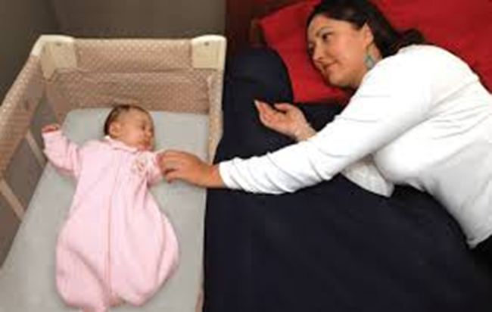
Room Sharing
Ideally for first year of life, but at least for the first six (6) months
The American Academy of Pediatrics recommends room-sharing, because this arrangement decreases the risk of SIDS by as much as 50% and is safer than bed sharing, or solitary sleeping (when the infant is in a separate room)
Notes:
Co sleeping means “caregiver and child sleeping in close sensory proximity)”. Both room sharing and bed sharing are forms of co-sleeping. This can cause confusion when educators advise to “not co sleep” so we are careful to use the terms room sharing or bed sharing and avoid using co sleeping, to be clear. This past October, the media really focused on the “at least 6 months, ideally the first year” part of the room sharing recommendation. This was not a new recommendation and is fact, the AAP softened their recommendations by adding in the language of “at least 6 months” previously they just suggested a year of room sharing. this is our opportunity to give information to parents for them to decide how long is best for them.

Slide 16

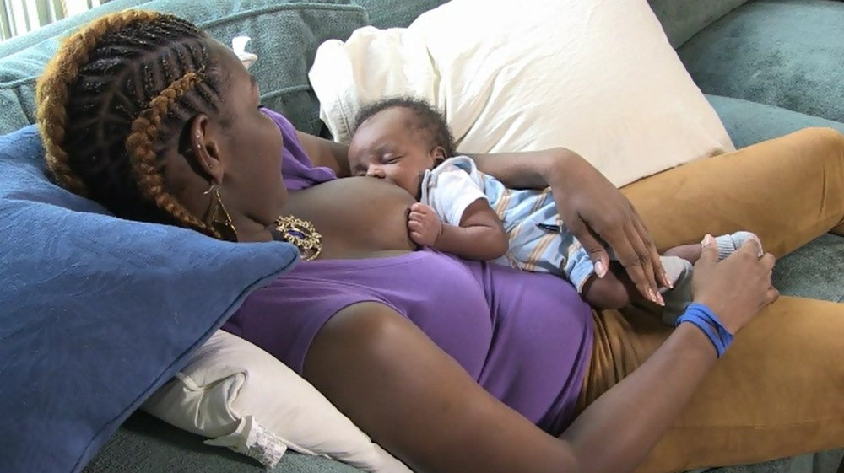
Falling Asleep While Feeding
It is not uncommon
  Avoid couches and chairs; lying on a flat surface is preferred
  Risk increases with length of duration and location
  Return baby to his/her own sleep space immediately upon waking
Notes:
Oxytocin – it will likely happen to everyone at least once. Better to be on a flat bed without any additional items than on a couch or armchair – good to up front and honest with parents about the likelihood and to encourage them to immediately place baby back to his or her own sleep space upon waking.

Slide 17
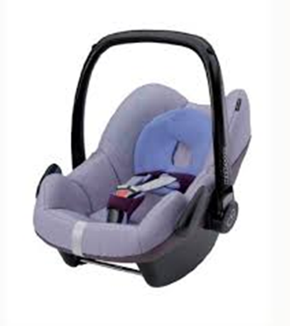
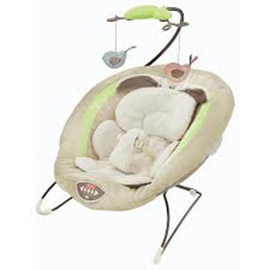



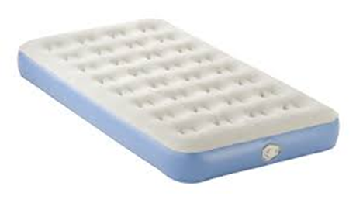
Unsafe Places for Baby to Sleep

Slide 18

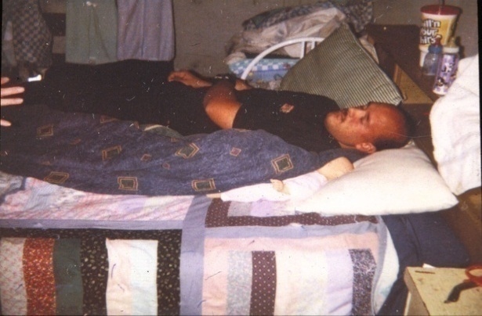

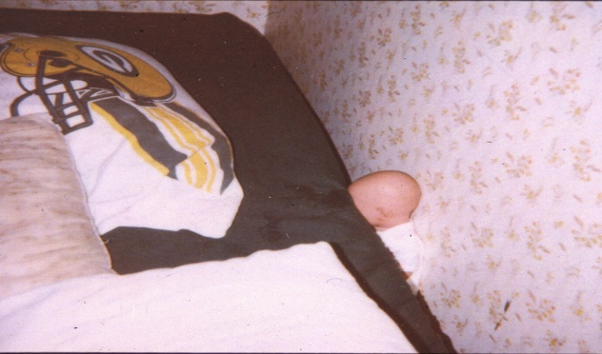
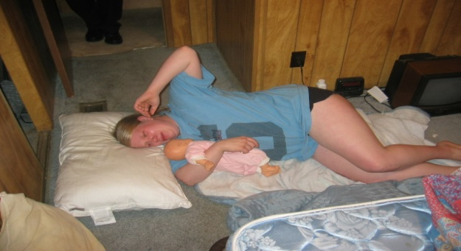
Accidental Suffocation & Strangulation in Bed Mechanisms
Suffocation
Overlaying (rolling on top of or against baby while sleeping)
Wedging or entrapment between mattress and wall, bed frame, furniture
Strangulation
Notes:
Accidental Suffocation and Strangulation in bed…if you remember from the slide at the beginning of our discussion, ASSB is one of the categories that is increasing in incidence. So what is ASSB and how does it happen?
ASSB, occurs when something limits a baby’s breathing like when soft bedding or blankets are against their face or when a baby gets trapped between two objects, such as a mattress and wall. Among babies, accidental suffocation is responsible for three quarters of all unintentional injury deaths.
1 - Suffocation by: Soft bedding, pillow, or waterbed mattress
2 - Overlaying or rolling on top of or against infant while sleeping
3 - Wedging and entrapment of an infant between two objects such as a mattress and wall, bed frame, or furniture
4 - Strangulation by: Asphyxiation, such as when an infant’s head and neck become caught between crib railings if a crib isn’t put together correctly. (no picture)

Slide 19
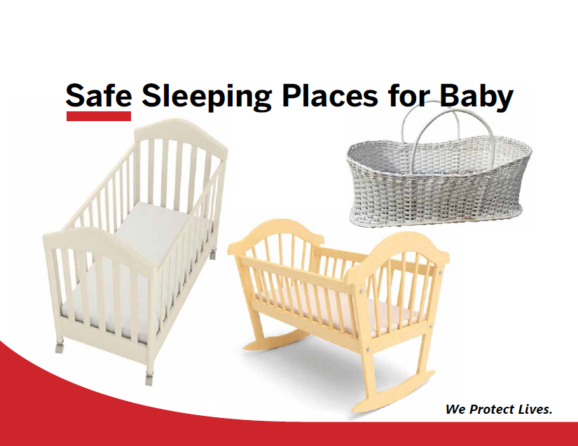
Notes:
Trainers Note: Please be aware that all “drop down” cribs (where the side slides up and down for easier access to the baby) are considered unsafe and no longer for sale. If a family has one, advise them to consider a different model. Additionally, the slats on a crib should be no wider than the bottom of a soda can – this helps to keep little legs and arms (and head) from getting stuck. Please check www.cpsc.gov to make sure your crib is not recalled.
ASK the Participant - What makes these sleep places safer for babies?
There is a firm mattress.
There are no blankets or pillows.
There are no toys or crib bumpers.

Slide 20
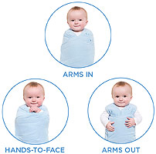
Swaddling & Safe Sleep
American Academy of Pediatrics Guideline - There is no evidence to recommend swaddling as a strategy to reduce the risk of SIDS.
If swaddling is used:
  It must be done correctly to avoid concerns of hip dysplasia, etc.
  Only thin blankets are to be utilized
  Parents should be reminded they still need to follow the safe sleep recommendations and they must discontinue swaddling as soon as the infant is able to “break free” from the swaddle
  Parents can also be encouraged to use a “swaddle sack”

Slide 21

Breastfeeding is Recommended
From the 2016 American Academy of Pediatrics Updates:
Breastfeeding is associated with a
reduced risk of SIDS. The protective
effect of breastfeeding
increases with exclusivity.
However, any breastfeeding has been
shown to be more protective against
SIDS than no breastfeeding.
Notes:
Physiologic sleep studies showed that breastfed infants are more easily aroused from sleep than their
formula-fed counterparts. In addition, breastfeeding results in a decreased incidence of diarrhea,
upper and lower respiratory infections, and other infectious diseases that are associated with
an increased vulnerability to SIDS and provides overall immune system benefits attributable to maternal
antibodies and micronutrients in human milk

Slide 22
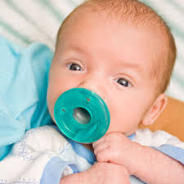
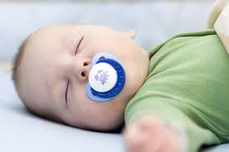
So why suggest pacifiers too?
Although the mechanism is unclear, studies have reported a protective effect of pacifiers on the incidence of SIDS.
The protective effect of the pacifier is observed even if the pacifier falls out of the infant’s mouth.
Decreased risk of SIDS ranging from 50% to 90%.
Notes:
Multiple case-control studies and 2 metaanalyses have reported a protective effect of pacifiers on the incidence of SIDS, particularly when used at the time of the last sleep period, with decreased risk of SIDS ranging from 50% to 90%.

Slide 23
American Academy of Pediatrics Recommendations
The American Academy of Pediatrics, in both the “Breastfeeding and the Use of Human Milk” and “Safe Infant Sleep Recommendations” suggest offering a pacifier at naptime and bedtime, once breastfeeding is established, typically after 3 to 4 weeks.
Notes:
From AAP breastfeeding policy: The AAP does not support a categorical ban on pacifiers
because of their role in SIDS risk reduction and their
analgesic benefit during painful procedures when breastfeeding
cannot provide the analgesia. Pacifier use in the
hospital in the neonatal period should be limited to specific
medical indications such as pain reduction and
calming in a drug-exposed infant, for example. Mothers
of healthy term breastfed infants should be instructed to
delay pacifier use until breastfeeding is well-established,
usually about 3 to 4 wk after birth.

Slide 24
What About Reflux?
All babies reflux
  Babies have protective mechanisms to keep their airway safe
  The back position is still the safest
Elevating the head of the bed is not recommended¹
  Does not help reflux
  Baby may slide to the foot of the bed and compromise airway
Rare exceptions: Example - compromised airway protective mechanisms (such as grade 3-4 laryngeal cleft before surgical repair)
American Academy of Pediatrics. Policy Statement: SIDS and Other Sleep-Related Infant Deaths: Expansion of Recommendations for a Safe Infant Sleeping Environment. Pediatrics. 2011; 128: 1030-1039.
Notes:
The supine sleep position does not increase the risk of choking and aspiration in infants, even in those
with gastroesophageal reflux.

Slide 25
Notes:
The Safe Sleep Seven
If a mother is:
1. A non-smoker
2. Sober
3. Breastfeeding
And her baby is:
4. Healthy
5. On his back
6. Lightly dressed and unswaddled
And they:
7. share a safe surface
Then the baby’s risk of SIDS is no greater than in a crib, and any breathing hazards have been hugely reduced.

Slide 26
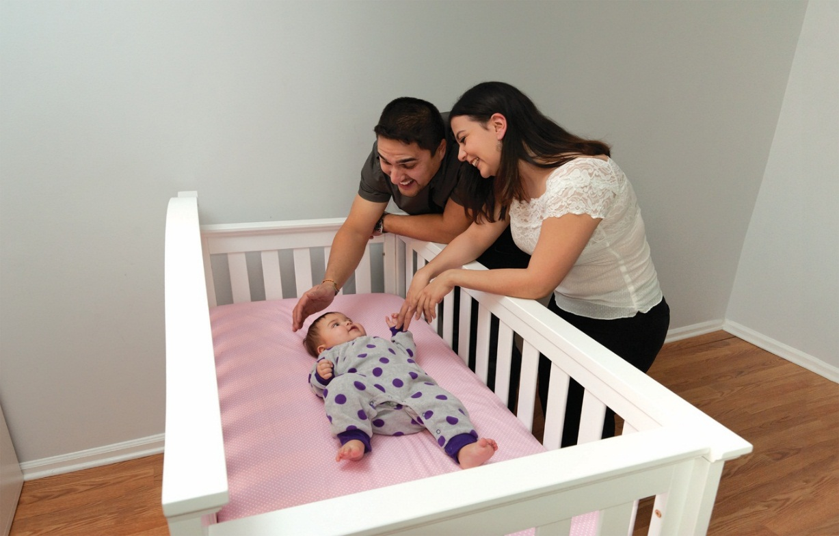

Thank you!
Any Questions or Concerns?
Terri Miller, MPH, CHES
Georgia Safe to Sleep Campaign Coordinator
terri.miller@dph.ga.gov
404-657-2904

