Slide 1

WIC Infant & Child Formula Algorithms
Kylia Crane, RDN, LD
Nutrition Coordinator
Georgia Chapter-American Academy of Pediatrics
kcrane@gaaap.org
404.881.5093

Slide 2
Infant Formula Algorithm 2012
Created by Stanley Cohen, MD - Pediatric Gastroenterologist (This project is a part of a contractual agreement between GA WIC and GA AAP- funded by GA WIC)
Disseminated statewide (office visits & annual meetings)
Special Edition Newsletter of The Georgia Pediatrician
Dr. Cohen presented at annual National WIC Association Meeting
Trainings for WIC staff, pediatricians, family physicians, and pediatric nurses
Interest from other state WIC programs

Slide 3
Infant Formula Algorithm 2012
Basis:
Provide a better understanding of special formulas (overabundance of types of formulas in market)
Provide guidance on prescribing of specialty formulas (prescribed more often than expected)
Decrease confusion of formula name/sizing changes (changes occur frequently)
Decrease confusion on “additives” in specialty formulas (confusion/lack of understanding of components added to formulas with families and physicians)

Slide 4
Infant Formula Algorithm 2012
Objectives:
Review common GI conditions in which specialty formulas are medically indicated
Discuss prescribing of specialty formulas based on medically appropriate diagnoses vs. manufacturer biased marketing
Decrease parental influence in the prescribing of specialty formulas
Identify evidence based recommendations for specialty formula selection

Slide 5
Infant Formula Algorithm 2012
Objectives continued…
Provide guidance for common conditions such as gastroesophageal reflux, infantile colic or irritability, allergies, rectal bleeding/colitis, malabsorption, and decreased weight gain
Note - Lactose reduced formulas are not covered due to extremely low incidence of true lactose intolerance in infants

Slide 6
Infant Algorithm 2017 Activities
Review of literature validates current evidence: No changes to algorithm (Completed)
Resource guide update to reflect current formulas (Completed)
Reprint and Distribution to WIC CPAs and Pediatricians (March/April)

Slide 7
Infant Algorithm 2017 Activities
Continued…
Outreach activities & training opportunities (April-July)
Webinar to be completed in May (Date TBD)
Evaluation will be conducted on the effectiveness of the algorithm and resource guide. Will be distributed to WIC Staff and Physicians (August)

Slide 8
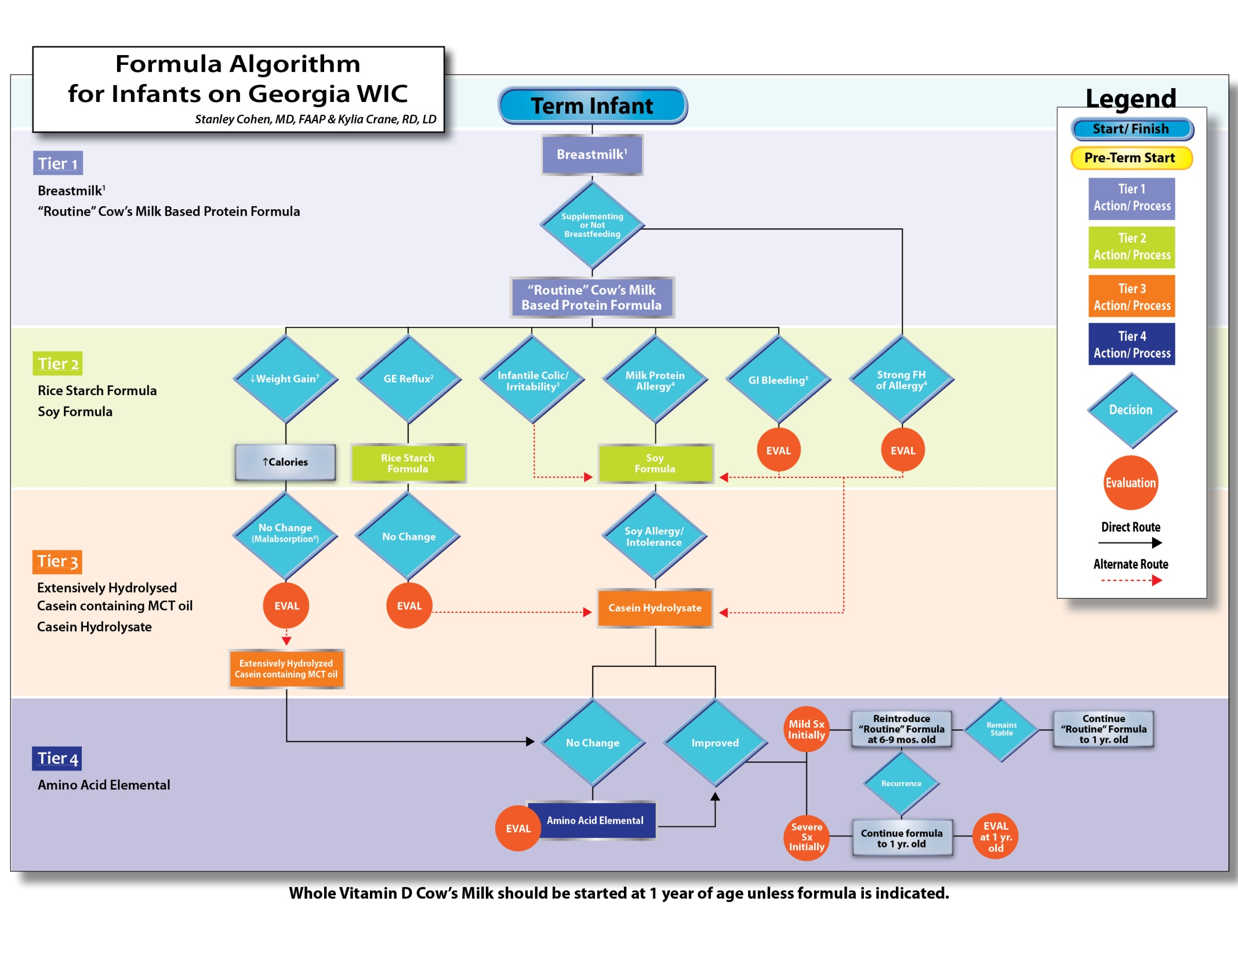

Slide 9
Tier 1

Slide 10
Tier 2

Slide 11
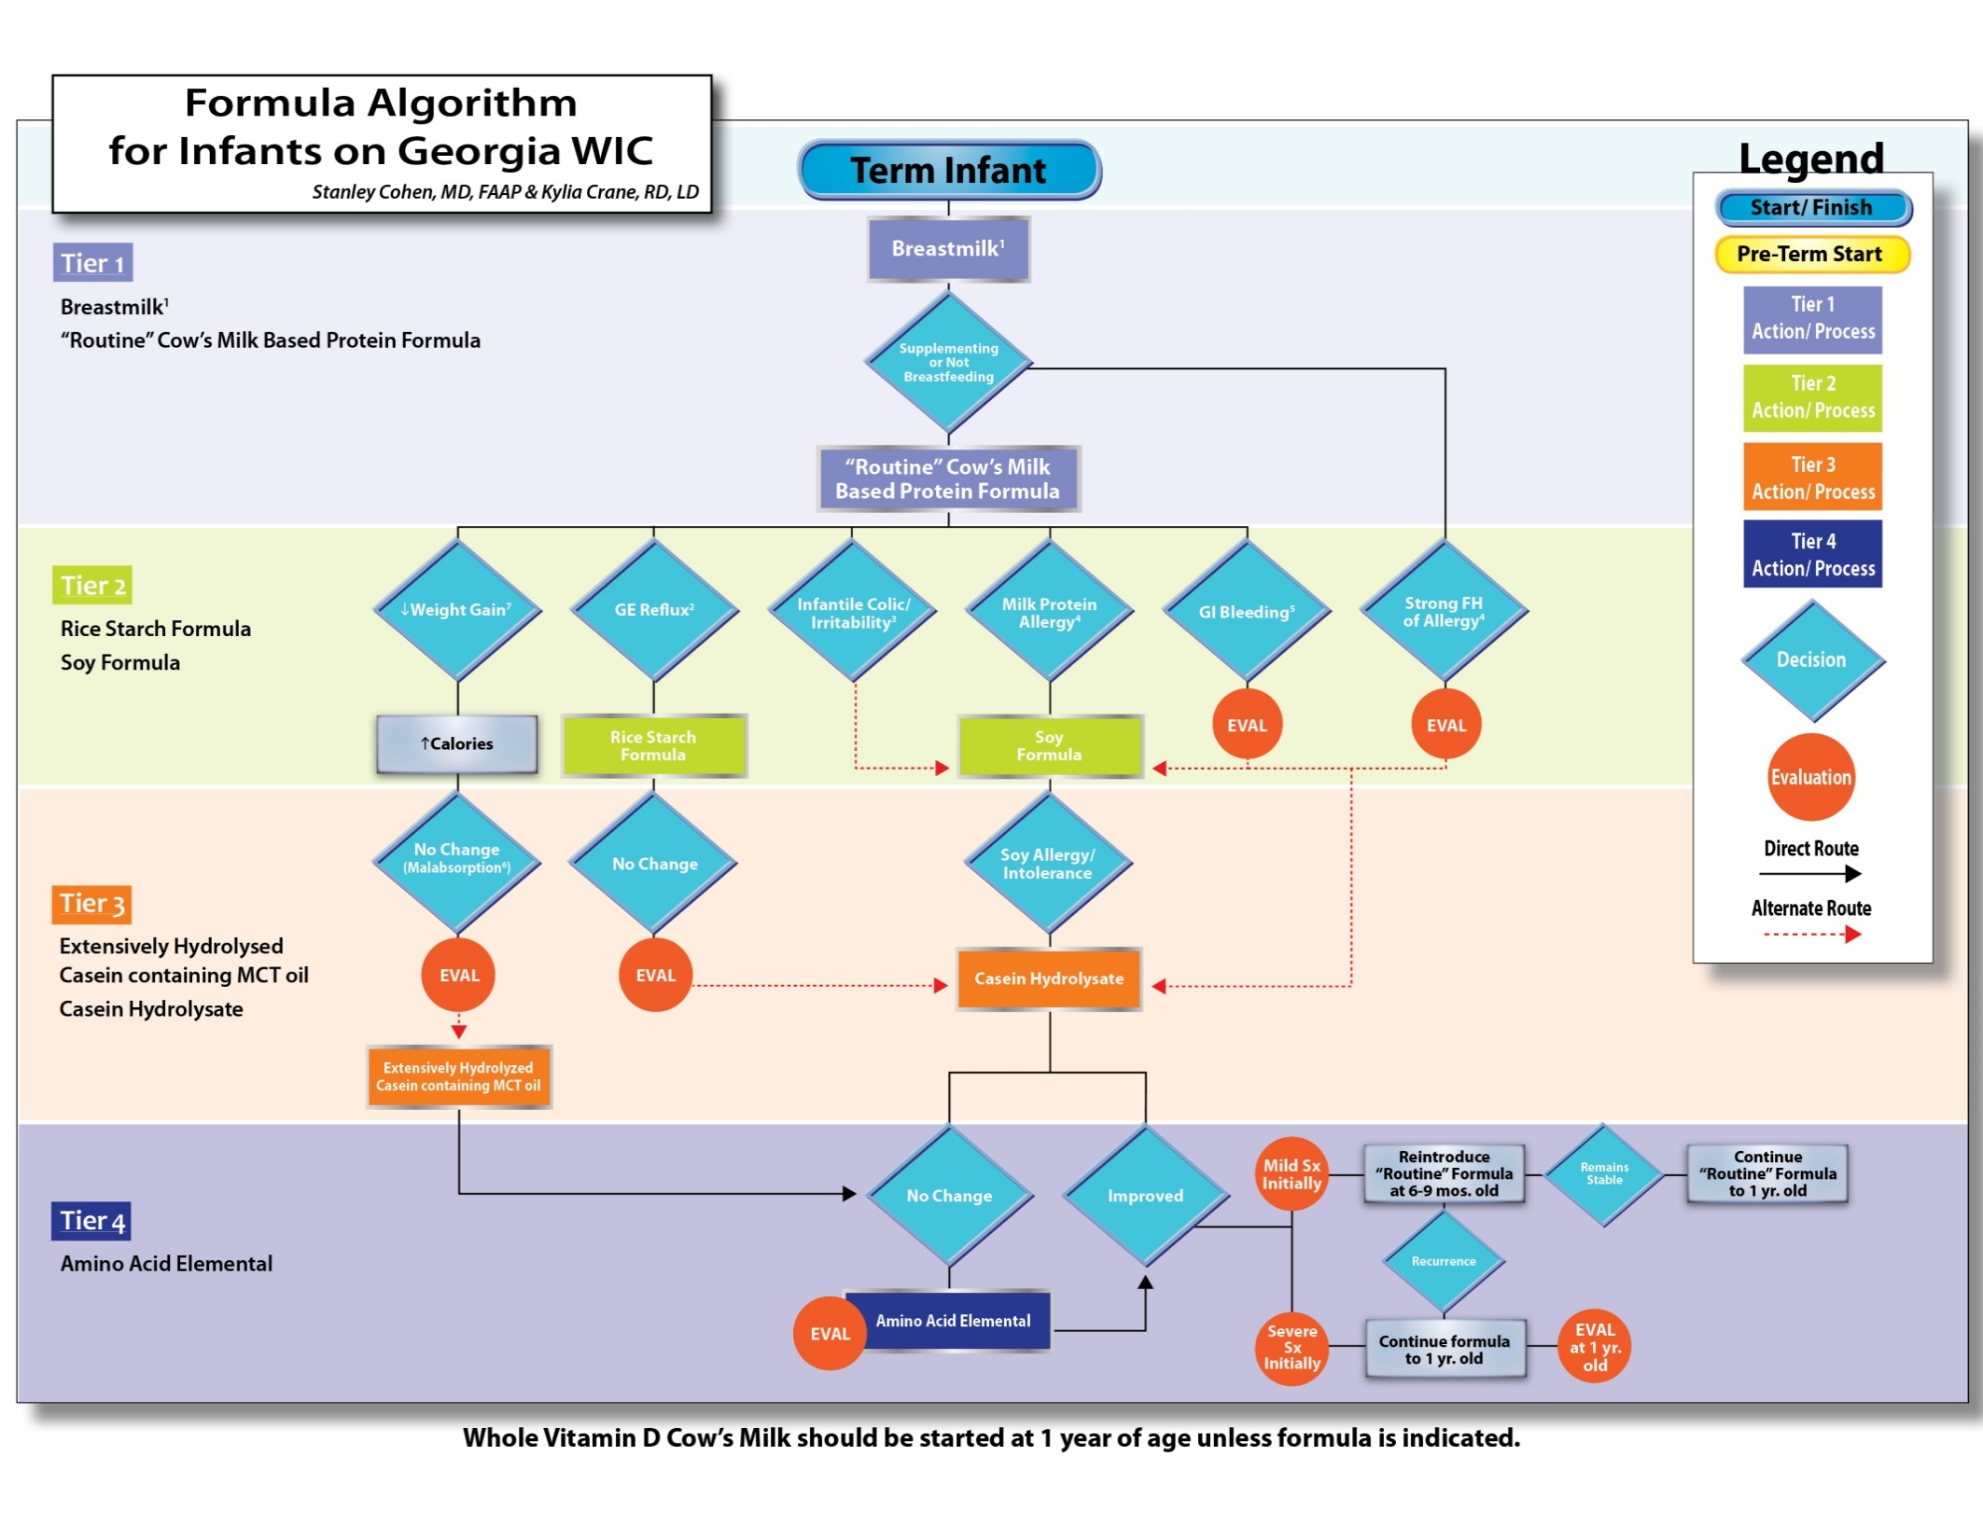
Tier 3

Slide 12
Tier 4

Slide 15
Child Formula Algorithm
Project led by Stanley Cohen, MD and Jay Hochman, MD both pediatric gastroenterologists (This project is a part of a contractual agreement between GA WIC and GA AAP- funded by GA WIC)
Progress to date:
Identified best practices
Developed algorithm (several drafts and updates completed)
Completed child algorithm resource guide
Launch for initial vetting

Slide 16
Child Formula Algorithm (NEW)
Basis
Need to create expanded special formula algorithm / guide that provided direction on formulas for children
Toddler formulas – what is an appropriate diagnosis and when to issue
Evidence based guidelines
Format similar to the Infant Formula Algorithm for ease of use by medical providers and WIC Staff

Slide 18
Tier 1 & Tier 2: Standard Milk Package and Milk Alternatives

Slide 19
Tier 3
Protein Hydrolysate Formulas
Enteral Nutrition
High Calorie Formulas

Slide 20
Tier 4
Amino Acid Elemental Formulas
Metabolic/Specialty Formulas

Slide 27
Child Formula Algorithm - Next Steps
Print final Child Special Formula Algorithm and Resource Guide for distribution to medical providers and Georgia WIC staff statewide (Projected May 2017)
Provide education to medical providers and WIC staff statewide (Projected May-August 2017)
May Webinar by Drs. Cohen and Hochman (Projected May 2017)
Office visits to providers (Projected May-August 2017)
Blast communications (emails) (Projected May 2017)
Website (WIC and GA AAP) (Projected May 2017)
Disseminate at biannual meetings for pediatricians and pediatric staff (nurses, medical assistants, and practice managers (May, June, Oct., & Nov.)
Evaluations to determine use and effectiveness (30 day post training)
Provider visits and follow-up
Surveys

Slide 28

Questions? Contact Kylia Crane, RDN,LD kcrane@gaaap.org 404.881.5093

